Slide 1


femto-TECH, INC.
CRM-510LP CRM-510LPB & CRM-510LP/CO Device Training Course
for NRPP Certification

Slide 2
What is Radon (Rn)?
Radon is an invisible, odorless, tasteless, radioactive gas.
It is the product of decaying uranium found in the soil, rocks, and water all around the world.
As a gas, it seeps into your home or business through any cracks or holes present in the building's foundation, or even through your well water.
Once it makes it inside your building it becomes trapped, subjecting all residents to exposure.
Radon can also enter your home or business through gaps in suspended floors, gaps around service pipes, cavities inside walls, & construction joints.

Slide 3
Why test for Radon?
Radon is the second leading cause of lung cancer in the United States.
Most people do not know that their home has high levels of radon or that they should test for it.
Many people do not realize how harmful radon is.
The longer your exposure, the higher the risk to you.
This means if exposed continually starting at a young age, children are at a higher risk of lung cancer as they grow into adulthood.

Slide 4


Course Objectives:
Understanding the operation of CRM-510LP
Answer questions for operator
Industry updates
Hands-on training
Certificate of proficiency
Continuing education credits

Slide 5
“Four Rules of Radon Testing”
Always use an EPA approved testing device.
1
Always follow testing protocols.
2
Always document rules one and two.
3
Always comply with state regulations.
4

Slide 6
Important Radon Phone Contacts
AARST Radon Assoc. (866) 772-2778
EPA Radon Program (800) 767-7236
American Lung Assoc. (202) 785-3355
Eastern Training Center (732) 932-9271 X606
Midwest Training Center (833) 723-6222
Kansas State University (785) 532-6026
University of Chicago (773) 702-1234
NRPP (800) 269-4174
NRSB (866) 329-3474
femto-TECH, INC.
25 Eagle Ct.
Carlisle, OH 45005
(937) 746-4427 Office
(937) 746-9134 Fax

Slide 7

Testing at Time of Real Estate Transactions
EPA recognized the need for quick testing results.
Safeguards are put in place to reduce errors.
Represents a large portion of the market.

Slide 8


EPA’s Home Buyer’s and Seller’s Guide
How to test a home that is being sold.
How to hire a testing contractor.
How to interpret test results.
Not copyrighted
  Reproduce in entirety without alterations.
  Great marketing tool!

Slide 9

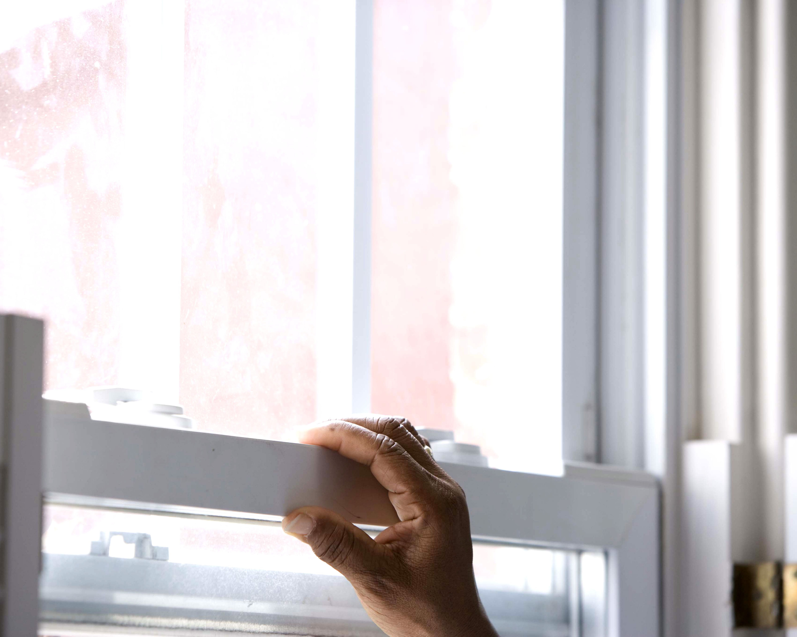
Closed House Conditions for All Short-Term Tests
All exterior doors and windows closed, except for normal entry and exit.
Internal-external air exchange systems off.
  Total internal recycle is allowed.
  Combustion or make-up air must not be closed.
  Permanent radon mitigation systems remain on.

Slide 10

Preparing for Short-Term Test i.e.,
Closing House Prior to Test
Tests lasting 2 or 3 days require closed house conditions 12 hours prior to testing.
  Allows house to come to dynamic equilibrium.

Slide 11

Test Placement for
Real Estate Transactions
In home purchase and sale, place test in lowest area “suitable for occupancy” … “without major renovations.”
  May require interpretation in some cases.
  Ultimately based on how the buyer will use the home.
  Relocation companies may decide to test lowest level that could be used by a buyer.

Slide 12
Providing a Professional Analysis
Since you cannot see or smell radon, special equipment is needed to detect it. You can buy radon devices in retail stores when you want to test your own home, send away for radon devices from laboratories that offer mail order services, or you can hire an EPA listed or state certified radon tester who will test using professional radon devices that are appropriate for the situation.
Preventing or Detecting Test Interference
There is a potential for test interference in real estate transactions. There are a number of ways to prevent or detect test interference such as:
Print-out report which frequently records radon or decay product levels to detect unusual swings.
Motion detectors to determine whether the test device has been moved or testing conditions have changed.
Proximity detectors to reveal the presence of people in the room which may correlate to possible changes in radon levels during the test.
Record of barometric pressure to identify weather conditions which may have affected the test.
Temperature record to help assess whether doors and windows have been opened.
Taping windows shut to ensure closed house conditions.

Slide 13

If You Conduct a Short-Term Test…
If you are testing in a real estate transaction and you need results quickly, any of the following three ways to conduct short-term tests are acceptable for determining whether the home should be fixed. Any real estate test for radon should include steps to prevent or detect device interference.
  Short-Term Testing Options
  Passive: Take an initial short-term test for at least 48 hours. After the first test has been completed, take a follow-up short-term test for at least 48 hours. Or take two short-term tests at the same time in the same location for at least 48 hours.
    Fix the home if the average of two tests is 4 pCi/l or more.
  Active: Test the home with a continuous monitor for at least 48 hours.
    Fix the home if the average radon level is 4 pCi/l or more.

Slide 14
Device Information:
Requirements for Use of Single
Continuous Monitor for Real Estate
Single, CRM, or CW must integrate and record hourly or more frequently.
Monitors that do not record at least hourly must be used with another passive or active device using either the sequential or simultaneous method.
First four hours of test may be disregarded, but 44 contiguous hours required for average.

Slide 15
Where Does the Device Go Within the Chosen Room?
(All Protocols)
Where it will not be disturbed.
Away from drafts caused by heating, ventilating and air conditioning, exterior doors, fans, and windows.
Away from heat and areas of high humidity.
At least 50 cm or 20 inches from the floor.
At least 10 cm or 4 inches from other objects.

Slide 16
Where Does the Device Go
Within a Room? (continued…)
For suspended detectors (e.g., hung from ceiling) an optimal height is 2.5 meters or 6 to 8 feet from the floor.
Not within 90 cm or 3 feet of exterior doors, windows, or other potential openings to the outside.
Not within 30 cm or 12 inches of an exterior wall.

Slide 17
Ways to Prevent or Detect Tampering
A print-out of continuous monitor helps detect unusual measurement swings.
Motion detectors can determine if the device was moved.
Proximity detectors reveal presence of people.
Record barometric and weather conditions.
Record room temperatures to assess the opening of windows.

Slide 18
Declaration of Voluntary Compliance Example

Slide 19
RAD-LAB Radon Report Example

Slide 20
Device QA Log Example

Slide 21
List of Continuous Radon Monitor Types (CRM)
Scintillation Cell and Photomultiplier Tube (PMT)
Pulsed Ion Chamber
Solid State Silicon Chip

Slide 22
Theory of Operation of Continuous
Radon Monitors (CRM)
Radon is collected from room by either a pump (active mode) or by diffusion (passive mode).
RDPs are filtered out.
Alpha particles from radon (active mode, also called sniffing) or radon and its RDPs (passive mode) are counted.
Measure radon, results in pCi/l.

Slide 23
What is Used to Measure the Alphas?
Scintillation cell with PMT
Pulsed ion chamber
Solid state silicon chip

Slide 24
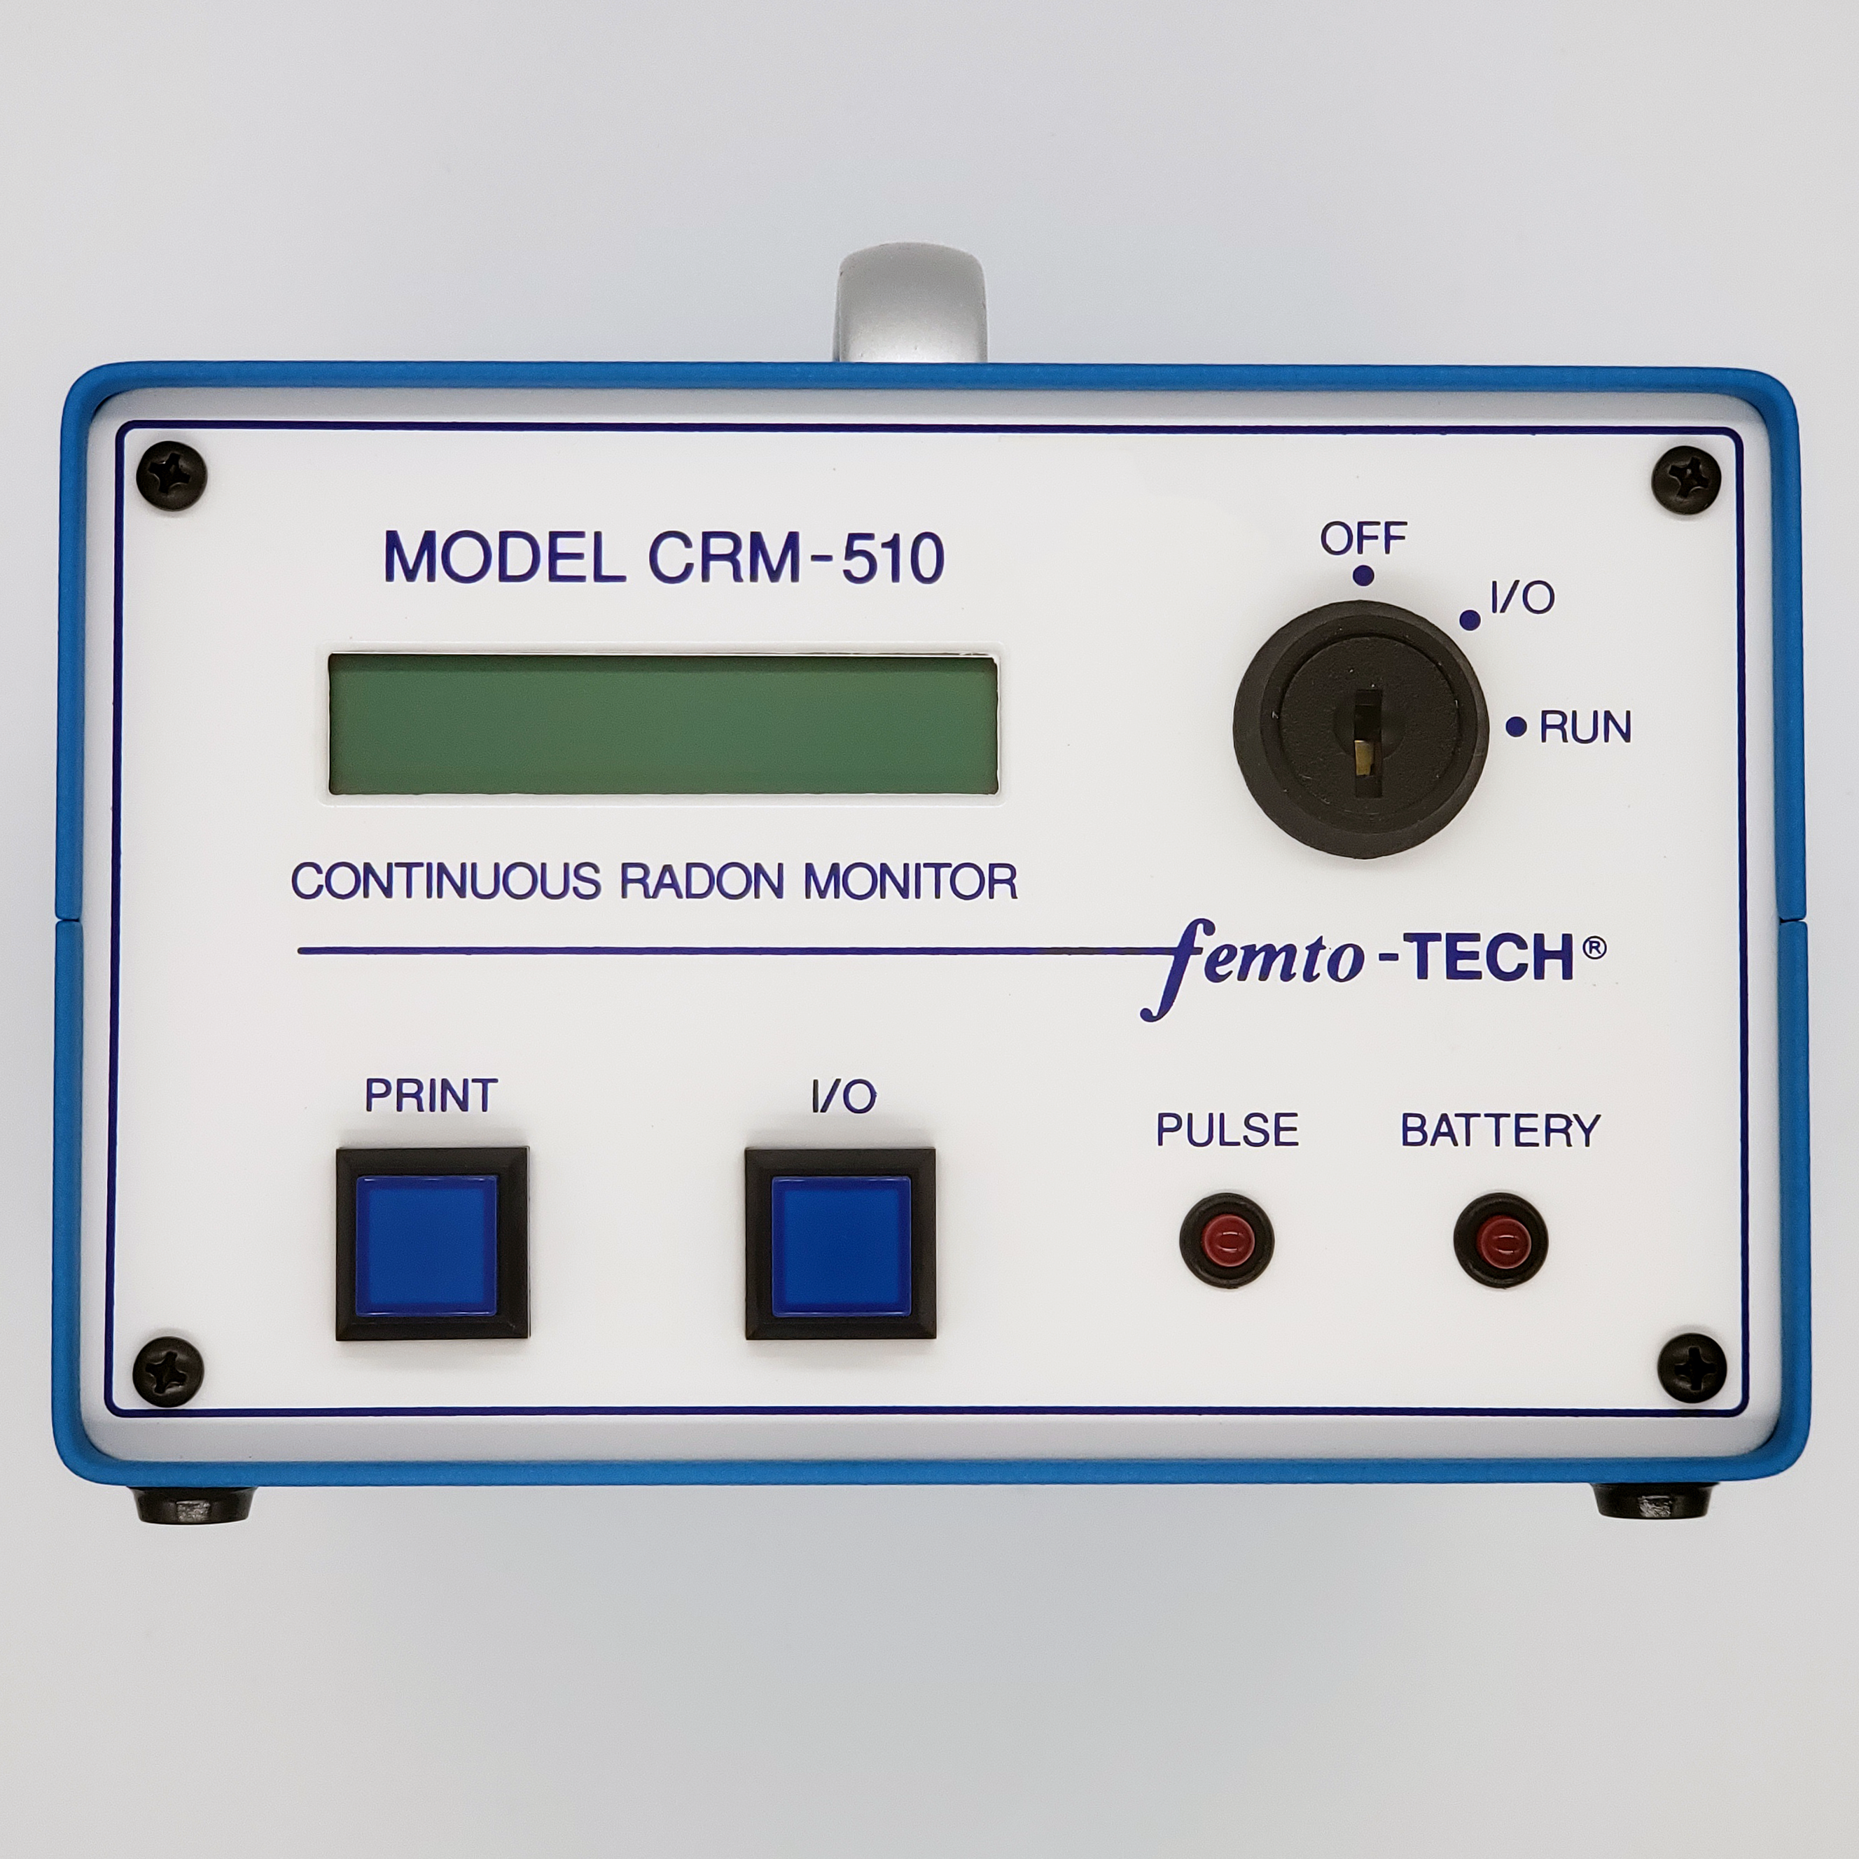
Pulsed Ion Chamber
Ions created from alpha radiation
Ions detected by electrometer
Results are short-term averages
Passive or active mode

Slide 25

Time Characteristics of
Sampling Methods
Time integrating
  Average over time
Grab (sniffing)
Continuous
  Trends and averages

Slide 26
Protocol Test Rules:
Single Test Option
The machine needs to record hourly.
The minimum measurement period is 48 hours.
There must be at least 44 continuous hours of usable data.
If the monitor cannot integrate over a period of one hour or less, then an additional (secondary) passive or active measurement device must be used. The two devices can be set up for simultaneously or sequentially.
Adding an extra feature to detect tampering could deter people from tampering with the equipment and keep the closed building conditions.

Slide 27
Protocol Test Rules:
Measurement Location
Use the lowest level of your home that can be used for occupancy to measure for radon.
Measurement should be done in a room that is used quite often.
If there is a basement that could be used for recreation or a bedroom without renovations, measure for radon there. The potential buyer will have the option of using the basement knowing it was measured for radon.

Slide 28
Protocol Test Rules:
Measurement Checklist
This checklist shows that the radon measurement was done properly. Seller or tester should be able to confirm all items were followed. If they cannot confirm then another test should be made.
Let occupants know how important proper testing conditions are.
Give them instructions on radon testing.
The service and device should be listed by EPA’s National Radon Measurement Proficiency Program or your State. Follow instructions that came with the device.
If using a professional use only EPA-listed or State-listed individuals. Ask to see photo I.D. Their contractor’s identification number should be on the test report.
Methods should be included to detect or prevent interference with testing conditions or the device.

Slide 29
Protocol Test Rules:
Measurement Checklist (Continued)
Minimum 48 hours for radon test. Some devices require longer.
Any exhaust fan that runs for a short amount of time may be used during the radon test.
For short-term tests less than four days, make sure an active radon reduction system fan has been running for at least 24 hours. Air exhaust equipment may stay running during testing. (Examples: Radon reduction system fans or small exhaust fans)
A radon test that lasts less than one week, should be done under closed-building conditions.

Slide 30
Radon Measurement Method Abbreviations
Method Category Abbreviations (Common)
Continuous Radon Monitors CRM
Alpha Track Detectors ATD
Electret Ion Chambers (Short Term / Long Term) EIC/EC
Activated Charcoal Adsorption Devices CC
Charcoal Liquid Scintillation CLS
Unfiltered Track Detectors UTD
Continuous Working Level Monitors CWLM
Radon Progeny Integrating Sampling Units RPISU

Slide 31
General Guidance:
Measurement Conditions (All building types)
Short-term measurements of 90 days or less the building should be in closed conditions. Windows, outside vents, and external doors should be closed except for normal entrance and exit for 12 hours prior to and during entire radon test period. External doors should not be left open. You can use them to exit and enter but do not leave the doors open for more than a few minutes.
The closed building conditions are a requirement for measurements lasting four days or less and are recommended for measurements lasting up to a week.
Turn off window fans, high-volume attic fans at least 12 hours prior to testing. A furnace or air conditioner can stay on.

Slide 32
General Guidance:
Measurement Conditions (All building types) Continued
Internal-external air exchange systems or air-to-air heat exchangers may be left on.
Any radon mitigation system should be left on during testing.
If there is going to be severe storms with high winds or rapidly changing barometric pressure do not conduct a short-term test lasting two or three days.
In southern climates, or a warm season the closed building conditions does satisfy the criteria listed above.
When normal living conditions does happen the closed building conditions must be verified and maintained more rigorously.

Slide 33
General Guidance:
Measurement Device Location Selection
Place the detector where it will not be disturbed and where there is plenty of room for it.
Do not place the detector near drafts caused by heating, ventilating and air conditioning vents, doors, fans, and windows.
Avoid areas with high humidity, excessive heat, like fireplaces or direct sunlight.
If there is a window or other opening place the detector at least 90 centimeters (3 feet) away.
Place the detector away from openings (e.g., windows) place the detector 30 centimeters (1 foot) from the walls.

Slide 34
General Guidance:
Measurement Device Location Selection
(Continued)
Place the detector at least 50 centimeters (20 inches) off the floor.
The detector should be at least 10 centimeters (4 inches) from all other objects.
A detector that is suspended, should be 2 to 2.5 meters (about 6 to 8 feet) from the floor.
Radon tests should not be conducted in the kitchen, laundry rooms, closets, or bathrooms.

Slide 35

General Guidance:
Documentation
The operator must use a permanent log to record information about the measurement for data interpretation and comparison.
Radon decay product measurements need to be recorded in Working Levels (WL). The WL value is converted to a radon concentration which is reported to the homeowner, it should be stated that this approximate conversion is based on a 50 percent equilibrium ratio. The report should indicate that the ratio is typical of home environments. Indoor environments such as schools or workplaces could have a different and carrying relationship with the radon and decay products.

Slide 36
General Guidance:
Documentation (Continued)
The following lists may be used to satisfy accepted measurement methods:
Dates, start, and stop times of testing.
Standardized measurement conditions are satisfied.
Exact location of the device, on a diagram of the room and building.
Type of building, heating system, crawl space, or basement, if occupants smoke, humidifiers, air filters, electrostatic precipitators, or clothes dryers should be listed.
Serial number and manufacturer of detector.
Code number or description which identifies customer, building, room, and sampling position.
Crawl space vents condition if open or closed.

Slide 37

Requirements Specific to Measurement:
Service Providers
Individuals and organizations providing analytical services must meet NRPP requirements for analytical measurement service providers. Analytical measurement services are defined as radon measurement services or activities, at a specific business location, that include the capability to extract, read, analyze, or manipulate radon/WL data from the measurement device(s) and calculate the final concentration for the client test report. These capabilities include, but are not limited to, reading and recording initial and final electret voltages, printing CM data tapes, recording radon or WL concentrations from a data window, or downloading the radon/WL data to a PC for test report generation.

Slide 38
Requirements Specific to Measurement:
Service Providers (Continued)
Individuals that are involved in any other part of a residential measurement, including consultation, placement, retrieval, etc., are listed for residential measurements services. Individuals that provide both analytical and residential services must apply to each category separately, unless his/her employer possesses an organizational listing for analytical measurement services for the specific device being used. Although EPA determines proficiency only for residential radon services, this does not preclude participants from offering non-residential radon measurement services which utilize knowledge or capabilities as demonstrated in the NRPP.

Slide 39
Requirements Specific to Measurement Service Providers:
Analytical Measurement Services
Those offering radon measurement services that include the capability to analyze or read radon measurement devices provide analytical measurement services. These listings are for the organization or individuals and are device specific. Device performance tests are required for such a participant to become listed. This test is scheduled once an Application has been accepted and the appropriate user fees paid. The test allows participants to demonstrate their ability to analyze accurately the level of radon to which their device(s) was exposed and to report the correct results. Successful participants are listed for a particular radon measurement device. Participants must have their listed devices calibrated at least annually to maintain their listing. They must also operate using an acceptable quality assurance plan (QAP), and meet other requirements described below. Successful participants are EPA listed and are issued Listing Letters to that effect. Participants may be listed for more than one brand/model/type of device if they meet the requirements and pay the appropriate user fees for each brand/model/type of device.

Slide 40
Requirements Specific to Measurement Service Providers:
Residential Measurement Services
The residential measurement service component of the NRPP evaluates the ability of individuals who enter the home to provide reliable radon measurement services in the home. This service may include consulting with the homeowner or realtor, placing and retrieving measurement devices, and/or providing the consumer with measurement results. To qualify for listing, individuals must pass a Measurement Exam and complete continuing education requirements every two years. Successful participants are EPA listed and are issued photo ID cards.

Slide 41
Program Requirements for Measurement Service Providers
Adherence to all the following requirements constitutes an EPA-conforming measurement.
Participants involved with real estate transactions must follow all described procedures in this section. As well as all requirements in the EPA's Protocols for Radon and Radon Decay Product Measurements in Homes.

Slide 42

Program Requirements for Measurement Service Providers:
Develop and Implement a Quality Assurance Plan (QAP)
During participation in the program all analytical measurement and residential measurement service participants are all required to develop, operate by, and maintain QAPs. This is an entrance and continuing requirement. Participants with analytical capabilities for each device that is listed with the company must have a QAP. When a participant applies to add a device to the listing, they must update the QAP. The participant must provide a QAP with details, practices, and procedures unique to the devices that provide radon measurement services. Residential measurement service providers that provide consumers with radon measurement services must have a QAP that is appropriate to any device. The QAP can be either the residential or analysis service providers.

Slide 43
Program Requirements for Measurement Service Providers:
Develop and Implement a Quality Assurance Plan (QAP)
(Continued)
At a minimum, QAPs developed by analytical measurement service providers must address all four of the elements discussed in the following slides. QAPs developed by residential measurement service providers that do not partake in any analytical services do not need to have a calibration section, however, the QAP must address the three remaining topics mentioned on the next slides. The EPA will emphasize these elements when reviewing and approving a participant’s QAP.

Slide 44
Program Requirements for Measurement Service Providers:
Chain of Custody
The QAP must demonstrate custody procedures for tracking specific measurement devices. All measurements performed in accordance with EPA procedures should have supporting documentation which provides complete chain-of-custody information including NRPP identification number of the analytical and residential measurement service providers. Residential measurement service providers must keep a record of all analytical measurement service providers that they use. This record should document the device(s) used and the NRPP ID number of the EPA listed analysis provider. EPA listed devices must each carry a unique identifier, such as a serial number. Analytical measurement service providers must keep a record of the EPA listed residential measurement service providers whose devices they analyze, and specific to the devices analyzed.

Slide 45
Program Requirements for Measurement Service Providers:
Calibration
The calibration procedure and schedule needs to be described. This shows when corrective action needs to be implemented or that the results of analyses are at acceptable limits. The calibration information must be attached to the continuous radon and continuous working level measurement devices. The calibration label should have on it; calibration facility, calibration date, and calibration expiration date. Calibration certificate or logs must be maintained for all devices covered by EPA listings. The calibration certificate is separate from the QAP. At anytime the EPA can request proof of calibration.

Slide 46
Program Requirements for Measurement Service Providers:
Checks for Background
The QAP should include instructions on how to assess the effect of background radiation on measurement results.

Slide 47
Program Requirements for Measurement Service Providers:
Spiked, Blank, and Duplicate Samples
Depending on the measurement device or method, a QAP must include regular use of one or more of these checks for bias and precision. Spikes are samples that are exposed to a known radon concentration. Blanks are unexposed samples. Duplicates are two or more measurements with identical equipment exposed over the same time interval at the same location.

Slide 48
Program Requirements for Measurement Service Providers:
Provide Information to Consumers and Clients
All participants listed for measurement services must provide consumer information as specified. This is a continuing requirement of the program. The EPA may evaluate compliance with this requirement through blind tests for an analytical service provider’s listed devices or special information requests from analytical or residential measurement service providers.

Slide 49
Program Requirements for Measurement Service Providers:
Provide Information to Consumers and Clients (Continued)
Participants may elect to provide information on obtaining mitigation services along with measurement results. EPA strongly recommends that you include a copy of facsimile of the Consumer’s Guide to Radon Reduction with the information you provide. Use of state-required mitigation brochures fulfills this requirement.
In states with a radon office, the participant must provide the client with the state radon program office phone number and inform them that a list of EPA approved mitigators is available from the state.

Slide 50
Program Requirements for Measurement Service Providers:
Have and Use Standard Operating Procedures (SOPs)
The use of acceptable standard operating procedures is both an entrance and continuing requirement of the Program. All analytical measurement service providers need to have a written, device-specific SOP in place for every radon measurement device that they have listed. Analytical and residential service providers can either create their own SOP or use the manufacturer SOP for their device. After applying, applicants and participants must provide a copy of their SOP(s) to the EPA upon request.
The SOP needs to include operating or analyzing procedures for the specific device. The SOP should also be consistent with EPA radon measurement protocols. (Next Slide)
The Agency can conduct an audit or make an information request to make sure the participant is adhering to device-specific SOPs on a day-to-day basis.

Slide 51
Program Requirements for Measurement Service Providers:
Follow Guidelines in Reporting Measurement Results
Radon measurement results must be provided to consumers with the following guidelines. The guidelines are an entrance and continuing requirement for participants. EPA can request a copy at anytime for the test report or notice given to consumers to verify they are meeting the requirement. EPA can also evaluate blind tests as part of their analytical measurement service providers.
Numerical Values: Radon gas must be reported no more than one decimal place, e.g., 4.3 pCi/L (picocuries per liter). Radon decay products (working level [WL]) must be reported no more than three decimal places, e.g., 0.033 WL.

Slide 52
Program Requirements for Measurement Service Providers:
Follow Guidelines in Reporting Measurement Results (Continued)
Timeliness: The consumer must have their test results to them within 30 calendar days after completion. Regardless if results are reported directly to consumer, it applies to both analytical and residential measurement service providers.
Minimum 48 Hour Measurement: Participants that offer analytical measurement services with devices designated as grab methods must provide consumers with written notification that grab sample results should not be used as the sole basis for deciding to mitigate. The results of grab sampling measurements and those of less than 48 hours are not appropriate for mitigation decision making.

Slide 53
Program Requirements for Measurement Service Providers:
Follow Guidelines in Reporting Measurement Results (Continued)
Consumer Measurement Result Disclaimer: If an analytical measurement service provider is delisted for a measurement device, he/she must notify their clients of the delisting. Test report must have the following disclaimer:
  “This radon measurement result was analyzed by an organization that does not currently meet the requirements of the U.S. EPA Radon Proficiency Program.”
If a residential measurement provider loses his/her listing, a similar caveat must be added to any reports provided by the individual to their clients.
In cooperation with the Consumer Federation of America (CFA), EPA has drafted a user-friendly test results letter for consumers that participants are encouraged to use.

Slide 54
Program Requirements for Measurement Service Providers:
Record Keeping
Listed analytical service providers need to have a record of all residential measurement service providers that use their analytical services. Also, residential measurement service providers must keep records of all analytical measurement services used for analysis and residential test reports. The list can be reviewed and compared anytime by the EPA. This is a continuing requirement of the Program.

Slide 55
Program Requirements Specific to Analytical Measurement Services
In addition to the requirements described previously, analytical measurement service providers must also adhere to the following Program specifications.
Analytical Measurement Service Providers Must Pass a Device Performance Test: All participants providing analytical measurement services must pass a device performance test to obtain a listing for a specific device. This applies to all devices for which a participant wishes to obtain a Proficiency Listing. The test will be scheduled for the next test window after the device application is accepted and user fees for that device are received. Test windows are conducted regularly throughout the year. The device performance test is designed to assess the participant’s ability to product accurate results.

Slide 56
Program Requirements Specific to Analytical Measurement Services: Analytical Measurement Service Providers Must Pass a Device Performance Test (Continued)
Analytical service providers are expected to provide measurement results that are within +-25% of EPA’s target value. They are also required to submit results to EPA in a manner consistent with requirements outlined that discusses procedures for the test.

Slide 57
Program Requirements Specific to Analytical Measurement Services: Analytical Measurement Service Providers Must Pass a Device Performance Test (Continued)
Device performance tests within the Program are either announced or blind. Announced tests are tests that the applicant knows about. Applicants submit their measurement devices, which are exposed to known radon concentrations in EPA laboratories. After exposure, the devices are returned for analyses. Blind tests are done without the applicant’s/participant’s knowledge. During blind testing, EPA acquires the device for exposure to a known concentration of radon, typically in an EPA radon chamber. The participant must then report the measured value, which is compared to the target value. In both announced and blind types of testing, analytical service providers are required to return accurate measurement results in accordance with all Program requirements. Participants who fail to do so are subject to delisting and applicants who fail will not obtain their listing.

Slide 58
Program Requirements Specific to Analytical Measurement Services: Analytical Measurement Service Providers Must Pass a Device Performance Test (Continued)
Devices will either be mail-in or walk-in for NRPP purposes. Devices that are shipped to EPA for radon measurement test exposure are mail-in. Devices that are dropped off at an EPA laboratory are walk-ins. Some participants are given either option. The agency can ask for a specific machine or specific operator. EPA at anytime can request information on your inventory and measurement technicians about portable or self-contained measurement devices.

Slide 59
Program Requirements Specific to Analytical Measurement Services: Analytical Measurement Service Providers Must Pass a Device Performance Test (Continued)
In announced tests, applicants must conduct all exposures and analyses in the same way that they are done for consumers. For example, device analyses must be done by the participating organization using equipment used in analyzing consumer measurements. Applicants must pass a test for each specific brand/model/type of radon measurement device for which they have applied. Most initial performance tests are announced and are conducted with the knowledge of the applicant. However, the Agency reserves the right to conduct blind tests at any time after receipt of a correct and complete Application. Blind test results may be used to determine whether an applicant receives initial listing, or a participant should be delisted.

Slide 60
Program Requirements Specific to Analytical Measurement Services:
Annual Calibration Requirement
Your device being calibrated annually is an important factor for accurate radon measurements to consumers. Analytical measurement service providers are required annually unless your manufacturer of your device recommends sooner for calibration. Calibration stickers must be placed on CR and CW devices: The stickers must have on them at minimum the calibration facility, calibration date, and calibration expiration date. All records and certificates for the devices that correspond to the Program listing must be keep at the analysis service. If records are not kept it will result in delisting. The participant is the one who pays for any cost that is associated with this requirement.

Slide 61
Program Requirements Specific to Residential Measurement Services:
Residential Measurement Service Providers Must Use EPA-Listed Analytical Measurement Service Providers
All NRPP participants providing residential measurement services must use a listed analysis provider to analyze the radon measurement device(s) they use. If it is the individual’s own company, that company must have a separate analytical listing and complete the requirements described above for analytical measurement services. This is a continuing requirement of the Program.

Slide 62
References:
EPA’s Home Buyer’s and Seller’s Guide to Radon & Consumer’s Guide to Radon Reduction
ANSI/AARST MS-QA 2019
ANSI/AARST MAH 2019

Slide 63
Operating Procedure for CRM-510LP
Start Test
Action | Screen Shows
(1) Turn-key to RUN position | Blank
(2) Push the PRINT button once | RUN, then goes to: pCi/l, "Hg, °F, or Bq/M³, kPa, °C
(3) Push the PRINT button again | DATE 01/01/20 (current date)
(4) Push and release both buttons at the same time | TIME 14:06 (current time)
(5) At this time, the device goes into Self-Test Mode This process takes about 20 seconds. When the test passes, the screen shows: At this time, the test is running If the screen says: Turn the key to OFF and push a button Start again from the beginning. If the device fails a second time, call femto-TECH for guidance | SELF TEST ACTIVE PASSED SELF TEST TEST STARTED! Count 0 SELF TEST FAILED
End Test
Action | Screen Shows
(1) Turn the key to the OFF position and push either of the buttons | TEST ENDED!
Note: Once you start a new test, the old data will be CLEARED!

Slide 64
Operating Procedure for CRM-510LP (Continued)
Print Test Using Seiko Thermal Printer
Action | Screen Shows
(1) Attach printer cable to device and printer | Blank
(2) Turn the key to I/O, turn printer on | Blank
(3) Press PRINT button once | TIME: xxxx min.
(4) Press PRINT button again | pCi/l "Hg, °F
(5) Press IO Button to select between TABLE or GRAPH printout. Press PRINT to select | TABLE | GRAPH
(6) Press IO button to select between USE ALL or SKIP 12. Press PRINT to select | USE ALL DATE | SKIP 1st 12 HRS
(7) Press PRINT button and data will begin printing
(8) Data may be printed again by repeating the above steps
Note: If closed house conditions were not met and the test time was extended:
During step #6, press the I/O button and the screen will say (Skip 1st 12 hrs), then push PRINT. This will skip the first 12 hours of data, preventing it from being included in the final test average.

Slide 65
Changing the Time on the CRM-510LP
Instructions
First, there must be no test data in the unit. Test Data must be cleared before changing the time!
(Be sure to print or download the data per printing instructions if you need data that is in the unit.)
To clear data: start a new test, waiting for the "SELF TEST ACTIVE" to complete and display "TEST STARTED!" Then, end the test by turning the key to OFF and pressing a button. The unit will display "TEST ENDED!" This will clear data from the unit.
Next, turn the key to I/O and press the PRINT button. As soon as "No Data to Print" is displayed, turn the key to RUN position.
The Time will be displayed in Hours/Minutes format, example: 9:17.
Use the PRINT button to change hours and the I/O button to change minutes. Pressing each button will accomplish this (hours will roll over at 23 to 0) (minutes will roll over at 59 to 0).
When the correct time is set, turn the key to the OFF position right away. The new time is set!
To check correct time setting, start a test and verify correct time during start up.

Slide 66
Radon Concentration Calculation for the CRM-510LP
Although the built-in computer normally performs all the computations and provides the radon concentration data in pCi/l or Bq/m3, it is advisable for the operator to know how to carry out "hand" calculations. A back-up "hand" calculation should be carried out after entering a new calibration factor or background value to verify their correct entry.
To perform a "hand" calculation, record the number of counts accumulated and the elapsed time shown on the LCD display, convert to counts per minute, and apply the conversion factor (C.F.) and background (BKG) values supplied with the instrument to obtain the radon level in units of pCi/l. The following formula is used for this conversion:
Rewritten:
pCi/l = (Ending Count – Beginning Count) - BKG
[Elapsed Time (in minutes) x C.F.]
The background subtraction is generally only necessary for radon levels below 10 pCi/l. Background of the Model CRM-510LP has been determined from aged air measurements to be in the range of 0.075 to 0.30 counts per minute. This corresponds to 0.25 to 1 pCi/l for a unit with a nominal 0.3 CPM/pCi/l calibration factor. The background does not vary significantly with time nor from unit to unit, because the pulsed ion counter detector and open grid chamber in the CRM-510LP discriminates against all ionizing radiation other than airborne alpha.
As a sample calculation:
pCi/l = (3150 - 0) - 0.5 pCi/l
[2880 minutes x .357 cpm/pCi/l]
pCi/l = 3150/2880 - 0.5 pCi/l (background in pCi/l, NOT cpm counts per min)
.357
Or
2.5 pCi/l
(2880 minutes is 48 hours)

Slide 67
Specifications – CRM-510LP
RADIATION DETECTED …......................................................................................................................... Radon-222 Alpha
DETECTOR …............................................................................................................................................ Air Ionization Probe
DYNAMIC RANGE …......................................................................................................... 1 to 200 pCi/l (37 to 7400 Bq/m³)
UNIT …............................................................................................................................................................... pCi/l or Bq/m³
SENSITIVITY …........................................................................................................................................ 0.350 CPM per pCi/l
…...................................................................................................................................... (0.01 CPM per Bq/m³)
LINEARITY .............................................................................................................................. 1 - 200 pCi/l (<10% Deviation)
SAMPLING MODE …............................................................................................................................... Passive Air Diffusion
DATA STORAGE:
CRM-510LP/B …...................................................................................................... 192 one-hour data points (8 days)
CRM-510LP/CO …................................................................................................... 79 one-hour data points (radon)
316 fifteen-minute data points (carbon monoxide)
ENVIRONMENTAL SENSORS:
TEMPERATURE …............................................................................................................... Range 50-104 °F, 10-40 °C
…................................................................................................................ Sensitivity ±1 °F, ± 0.5 °C

Slide 68
Specifications – CRM-510LP (Continued)
BAROMETRIC PRESSURE …........................................................................................... Range 0-38 "Hg, 0-127 kPa
…..........................................................................................................Sensitivity ± 0.2 "Hg, ± 0.5 kPa
RELATIVE HUMIDITY …....................................................................................................................... Range 0-90%
................................................................................................................................................... Sensitivity ± 5%
CARBON MONOXIDE ….................................................................................................................. Range 0-200 ppm
.................................................................................................................................................. Sensitivity ± 10%
DISPLAY:
ALPHANUMERIC CHARACTERS ….................................................................................... 16-Digit One Line LCD
LOW BATTERY INDICATOR …............................................................................................................. LCD Message
PULSE INDICATOR ….................................................................................................................................... Red LED
CONTROLS:
KEY SWITCH …................................................................................................................ OFF, I/O & RUN Positions
TWO MOMENTARY PUSH BUTTONS ….............................................................. Multifunction Select & Execute

Slide 69
Specifications – CRM-510LP (Continued)
EXTERNAL OUTPUTS (MALE DB-25P)
SERIAL …......................................................................................................................................................................... RS-232C
PARALLEL …................................................................................................................................... 8 Bit Simplified Centronics®
POWER:
ELECTROMETER …................................................................................................................ 9-volt battery (1-year nominal life)
ION CHAMBER …......................................................................................................... 27-volt battery pack (2-year nominal life)
COMPUTER/DATA LOGGER …................................................................... 7.2-volt lithium battery pack (1-year nominal life)
CARBON MONOXIDE SENSOR ….......................................................................... 9-volt lithium battery (1-year nominal life)
SIZE:
HEIGHT (w/Handle) …........................................................................................................................................... 5.4" (137 mm)
WIDTH …................................................................................................................................................................ 6.6" (160 mm)
DEPTH …................................................................................................................................................................. 7.4" (190 mm)
WEIGHT …..................................................................................................................................................................... 4 Pounds (1.8 Kg)
ENVIRONMENTAL OPERATING RANGE …....................................................................................................... 50-104 °F (10-40 °C)
….............................................................................................................................................. 10 to 90% RH (noncondensing)
Specifications subject to change 02/13/2020

Slide 70
Quality Assurance Plan, Standard Operating Procedure & Declaration Templates
Quality Assurance Plan Template
Standard Operating Procedure
Declaration of Voluntary Compliance
Click the documents above for access.

Slide 71

femto-TECH
RAD-LAB Software

Slide 72

RAD-LAB Software
Explanation of Features & Operation
RAD-LAB allows you to connect your femto-TECH CRM to the computer or mobile device of your choice to download and manage report data. This version of the software is our most feature-packed version to date, giving you the tools you need to analyze your protocol tests and customize/manage your report data with ease.

Slide 73
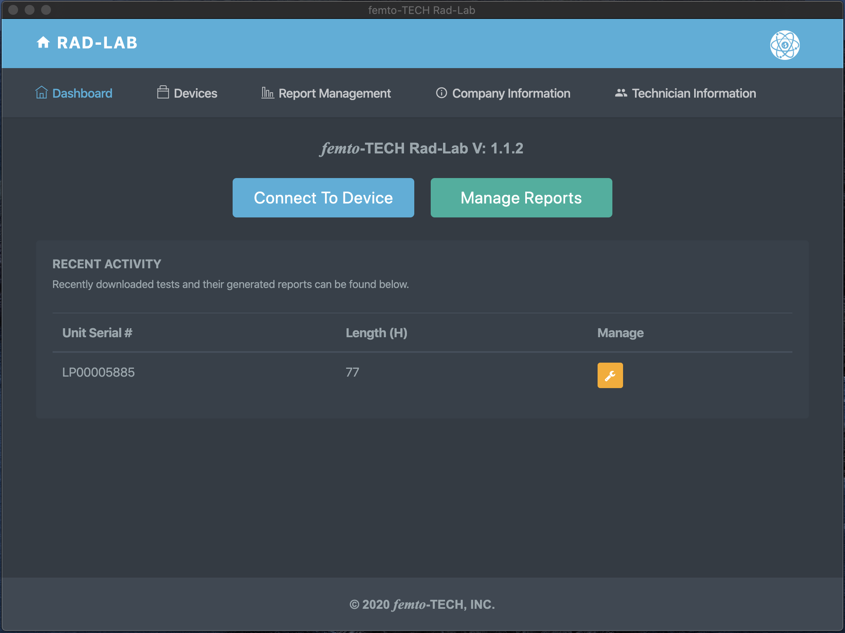

Getting Started
First things first, click the ‘Company Information’ tab to edit/save your company’s information and logo.
Once saved, this information will automatically be added to each of your generated reports.

Slide 74
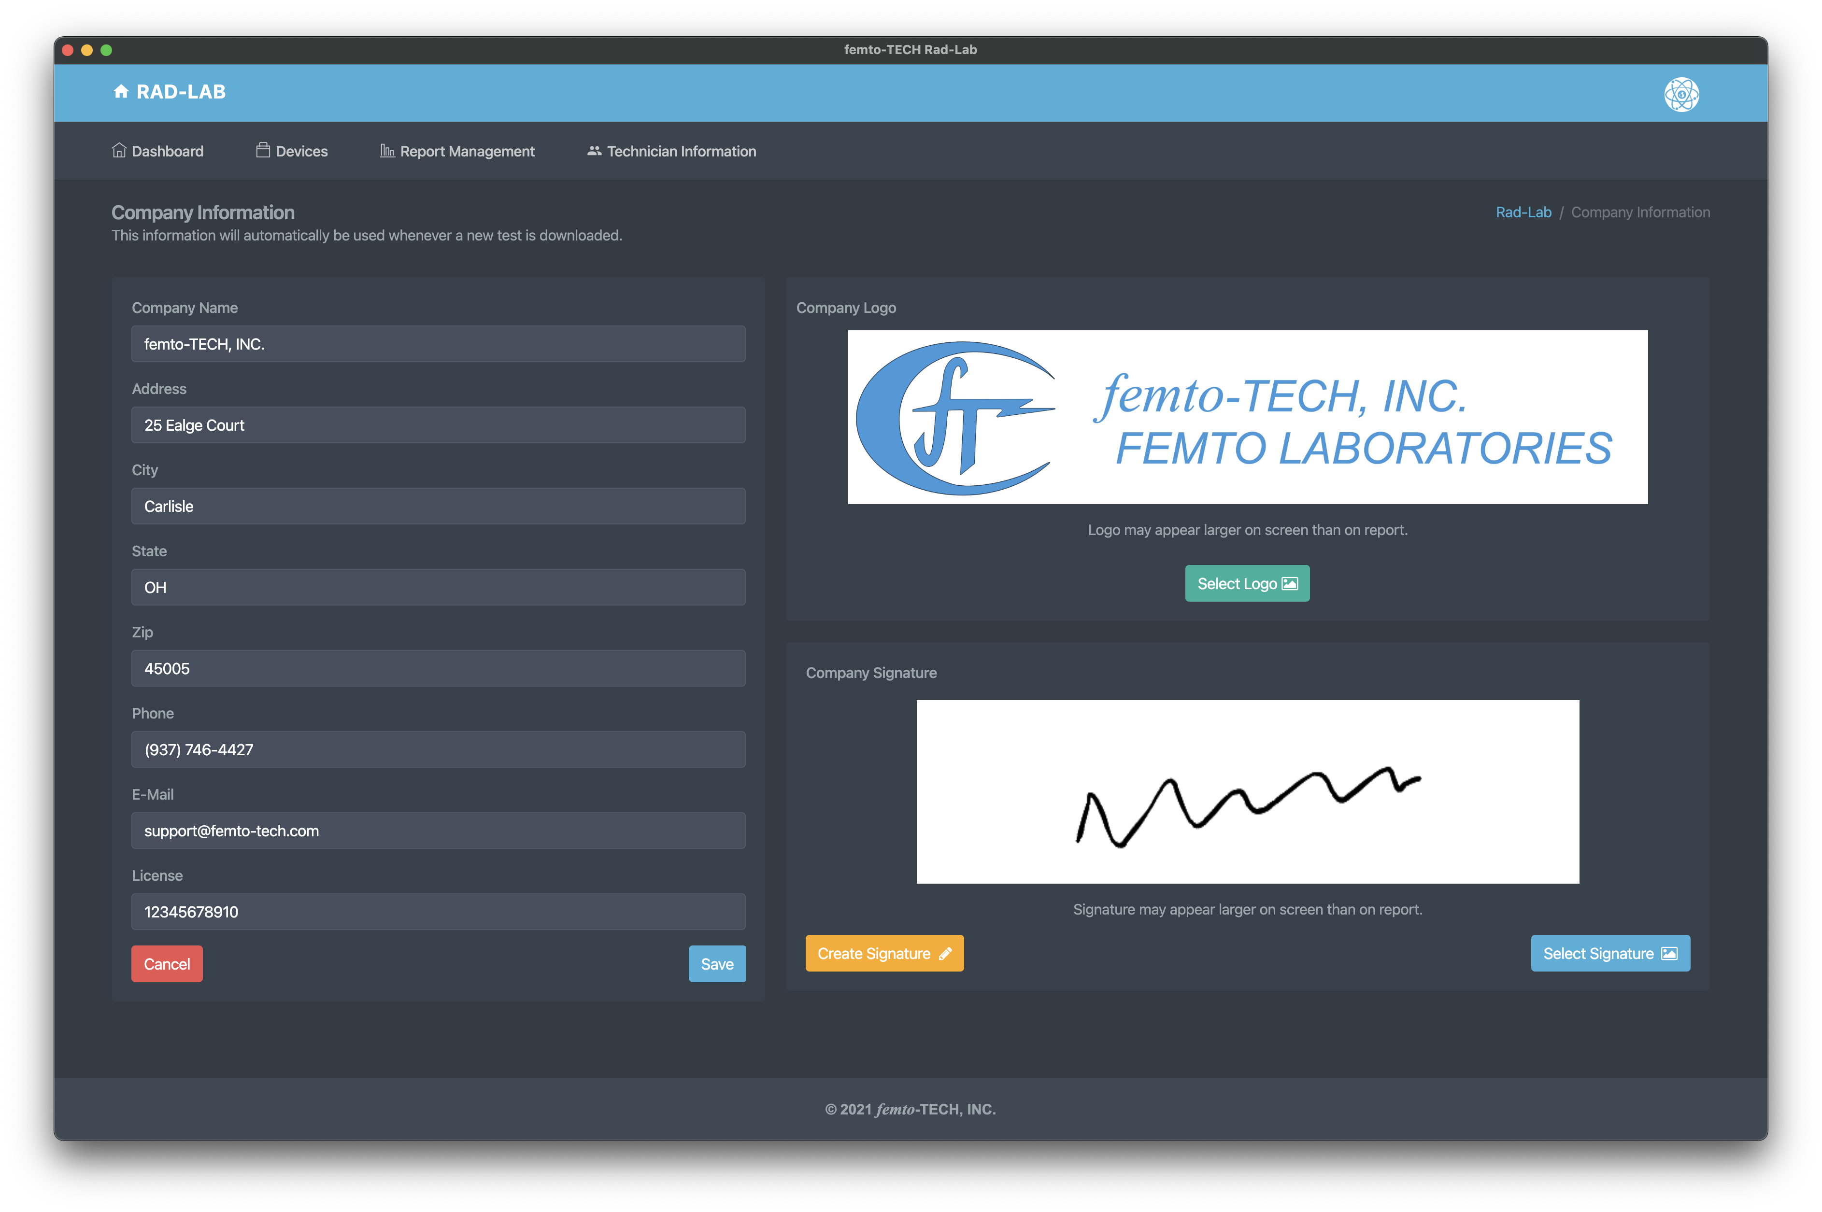
Company Information
Enter your company’s information to be automatically populated to each of your reports.
Select your company’s logo (optional) to be added to the top of each report.
Create or add a signature to be added on each of your reports.

Slide 75
Getting Started
(continued)
Next, click the ‘Technician Information’ tab to edit/save technician information

Slide 76
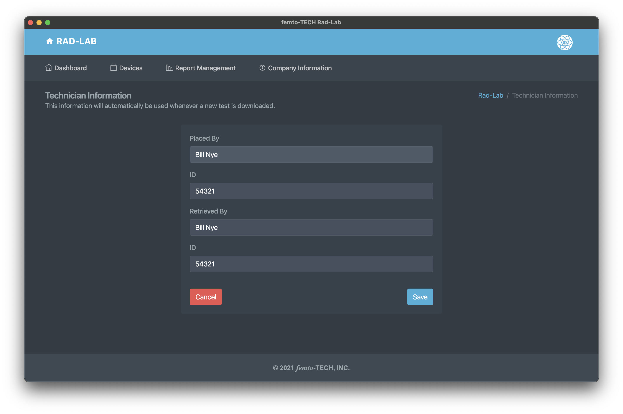
Technician
Information
Enter the name and ID of the technician(s) placing and retrieving the CRM that normally use the device.
This information can also be changed on the report itself.

Slide 77
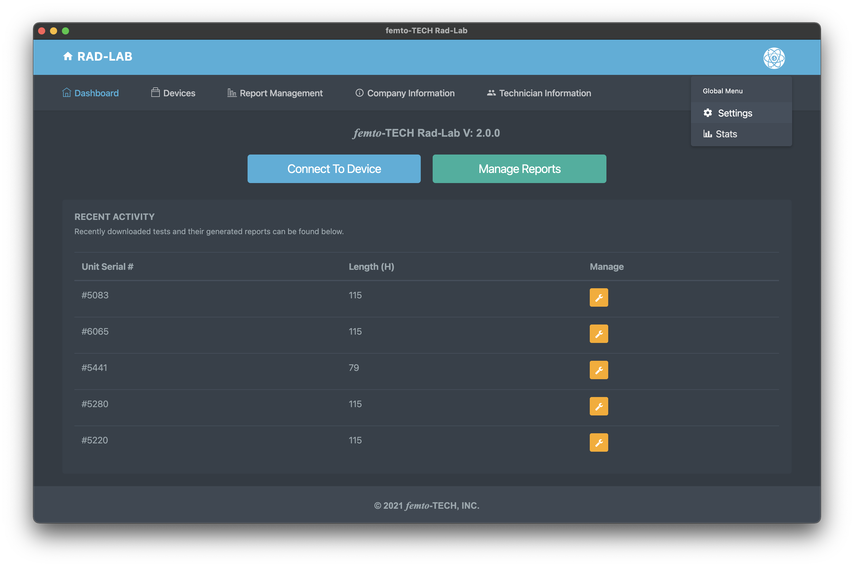

Getting Started
(continued)
Next, click the ‘Settings’ tab within the global menu in the top-right (circular icon) to further customize your generated reports.

Slide 78
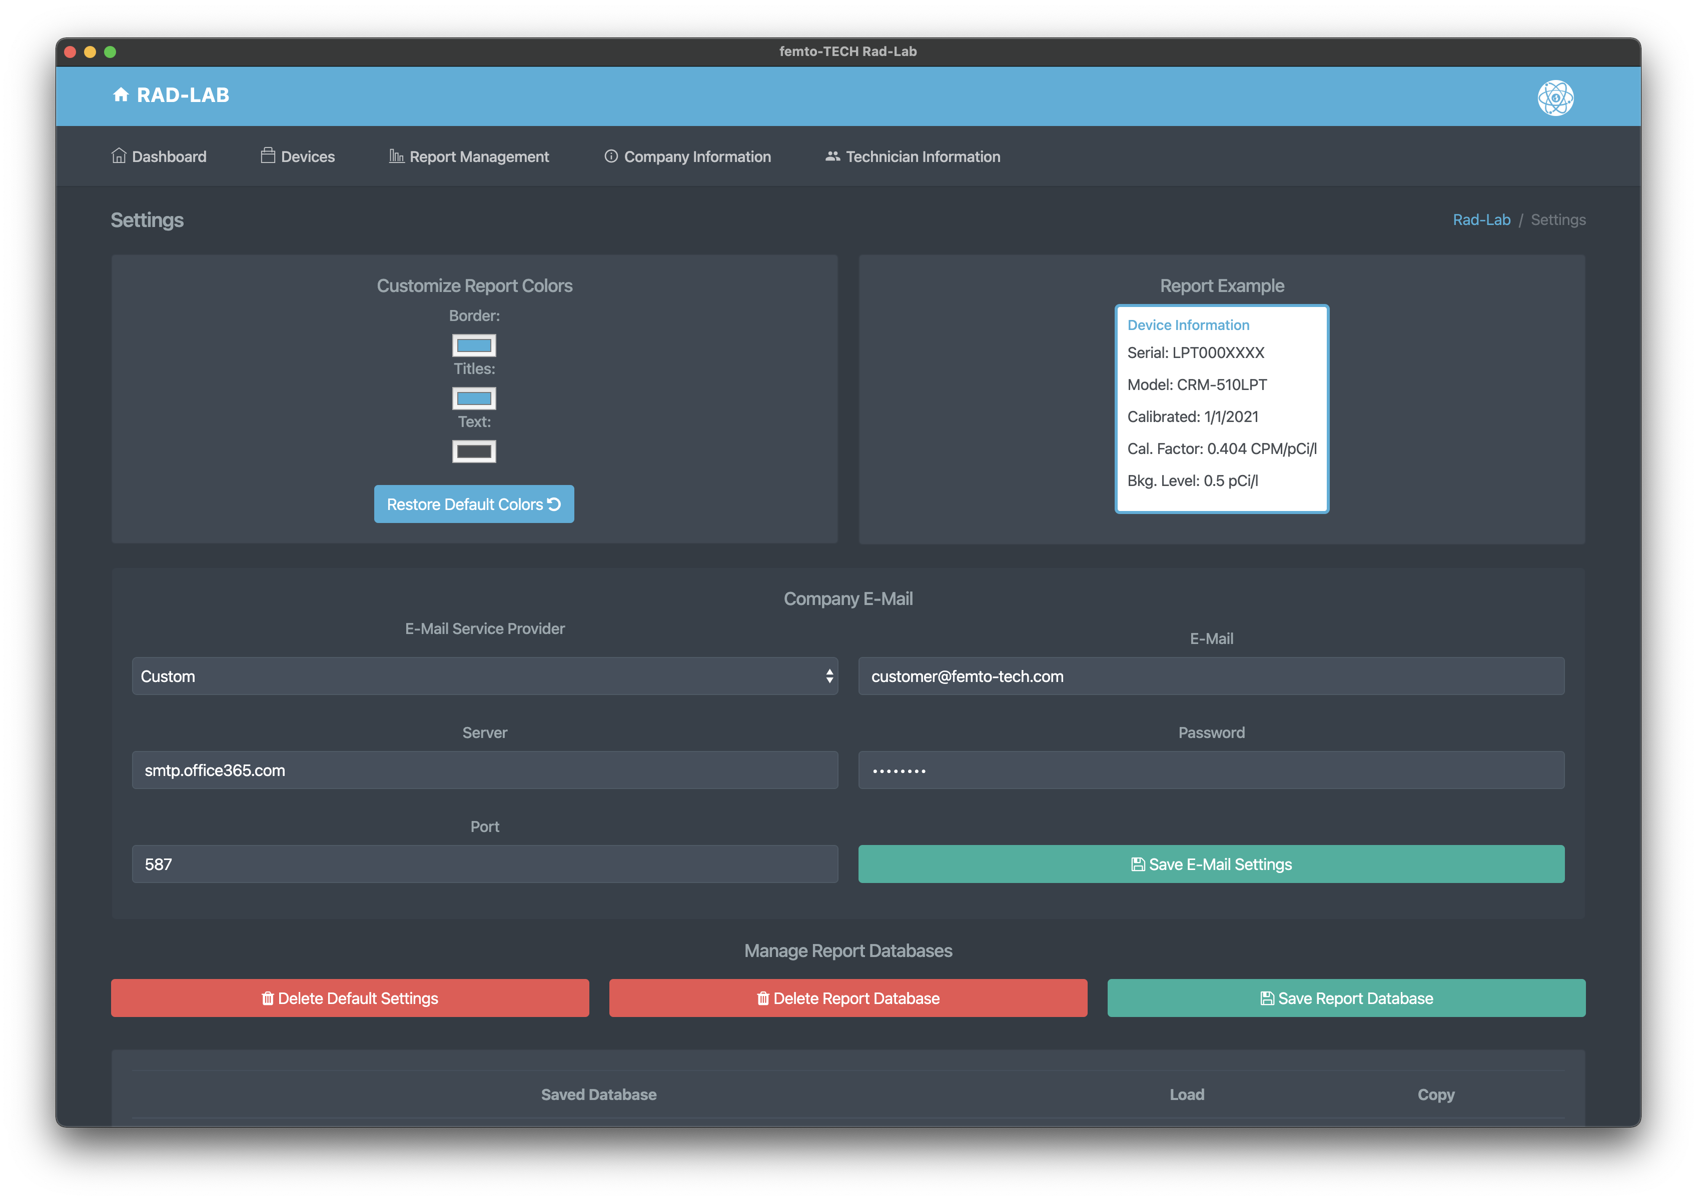


Customize Reports
Customize the colors on your reports by making color selections in the top-left.
Configure a company e-mail to be used to send reports directly once generated. If your company has no e-mail available or is unable to get it to work, femto-TECH provides an alternative option under ‘E-Mail Service Provider’. Select ‘femto-TECH’, and you will be able to send reports via customer@femto-tech.com. The Reply To address will be marked as your company’s e-mail from the ‘Company Information’ section, that way your customer can reply directly to you.
Company e-mail feature is optional. Most users prefer to save the report as a PDF and attach it to their own e-mail.

Slide 79
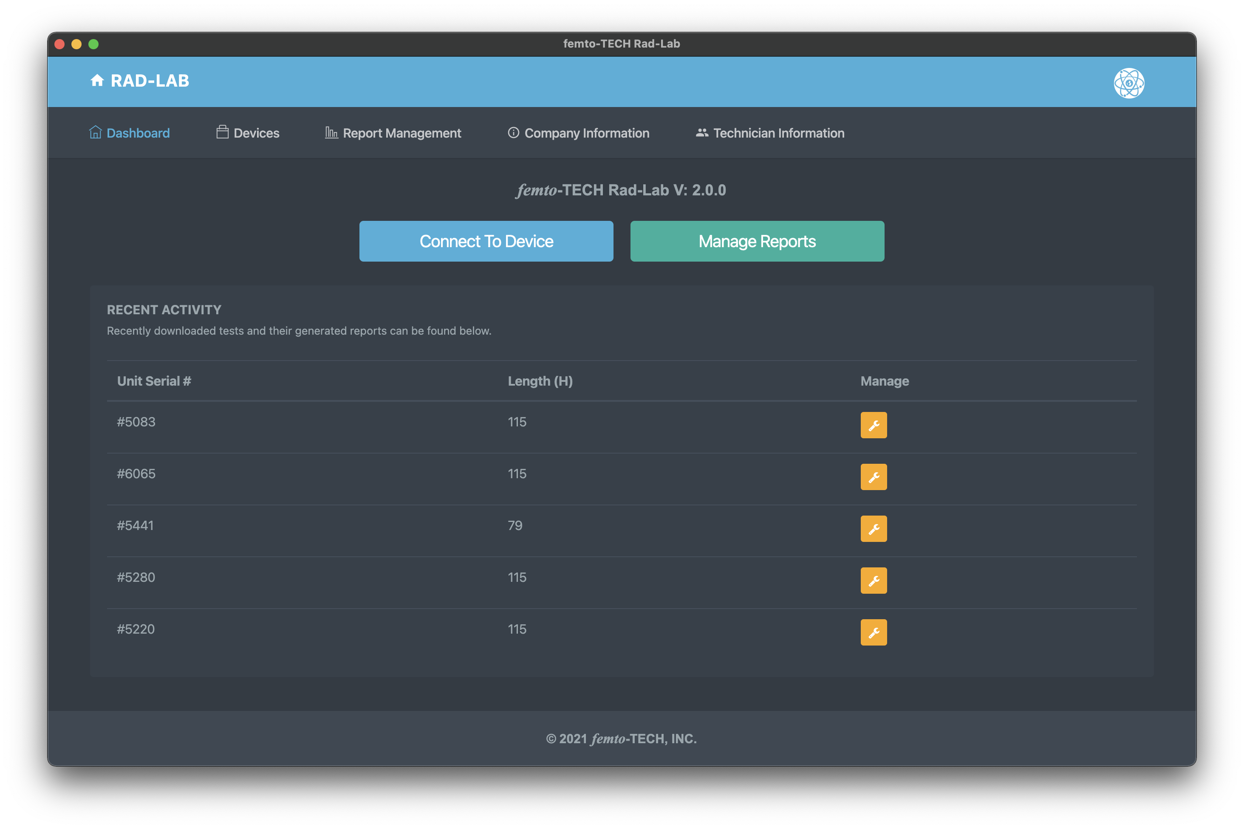
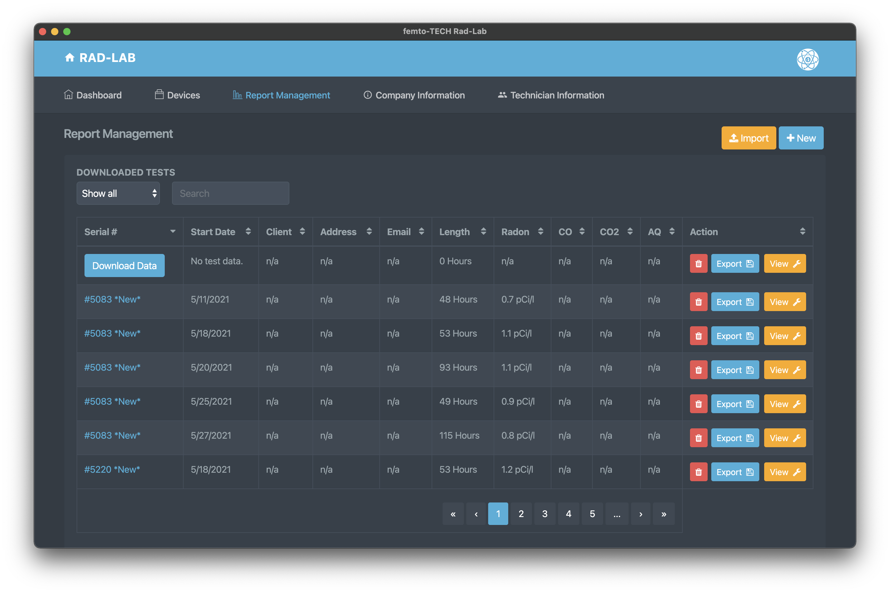



Download Data
Click either ‘Devices’ at the top left of the navigation bar or the ‘Connect To Device’ button on the Dashboard.
Data can also be downloaded to a previously created test entry by clicking ‘Download Data’ on the entry within the Report Management table.

Slide 80
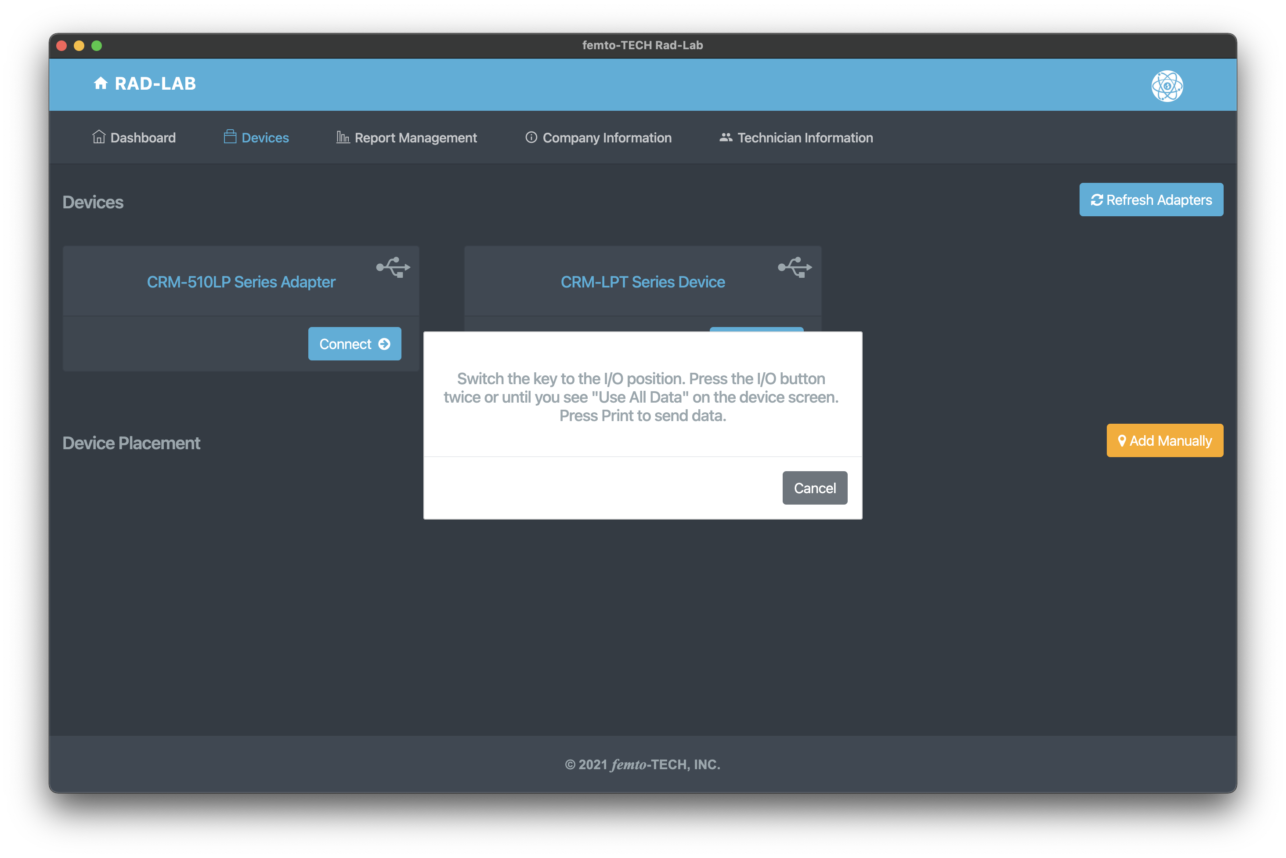
Download Data
(Desktop)
Plug the CRM-510LP into the computer using the provided download cable and then click ‘Refresh Adapters’.
Click ‘Connect ->’ on the adapter displayed on the screen and then follow the on-screen instructions to download the data. Once the data has downloaded, a ’Download Complete!’ message will appear and then take you to the ’Report Setup’ screen.

Slide 81
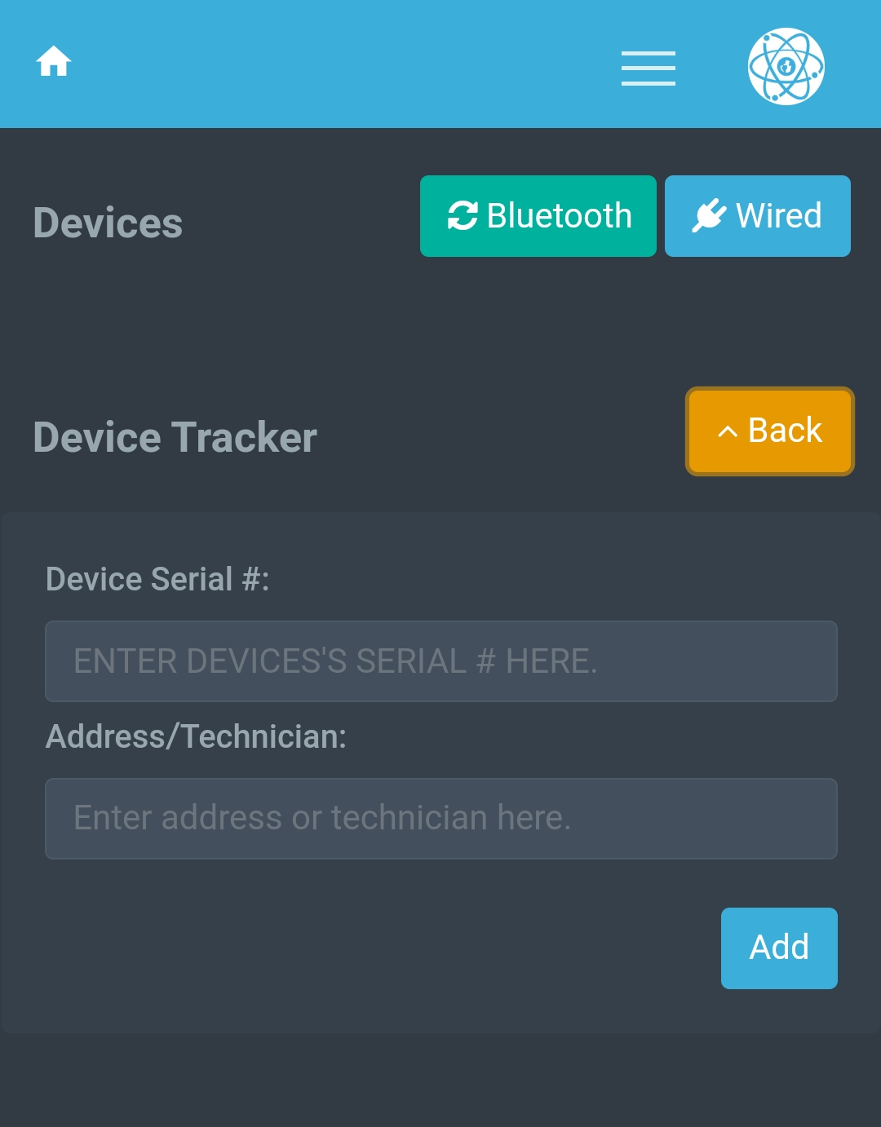

Download Data
(Mobile)
Plug the CRM-510LP into the mobile device using the provided download cable & OTG adapter and then click the ‘Wired’ button.
Follow the on-screen instructions to download the data. Once the data has downloaded, a ’Download Complete!’ message will appear and then take you to the ’Report Setup’ screen.

Slide 82



Report Management
Use the search bar or table navigation menu to browse downloaded tests. Here you can edit, import/export, & delete existing tests.
Click anywhere within the test entry on the table to expand it for more information.
Click on the blue serial # of the entry or the ‘View’ button to load the test into the ‘Report Setup’ screen.

Slide 83
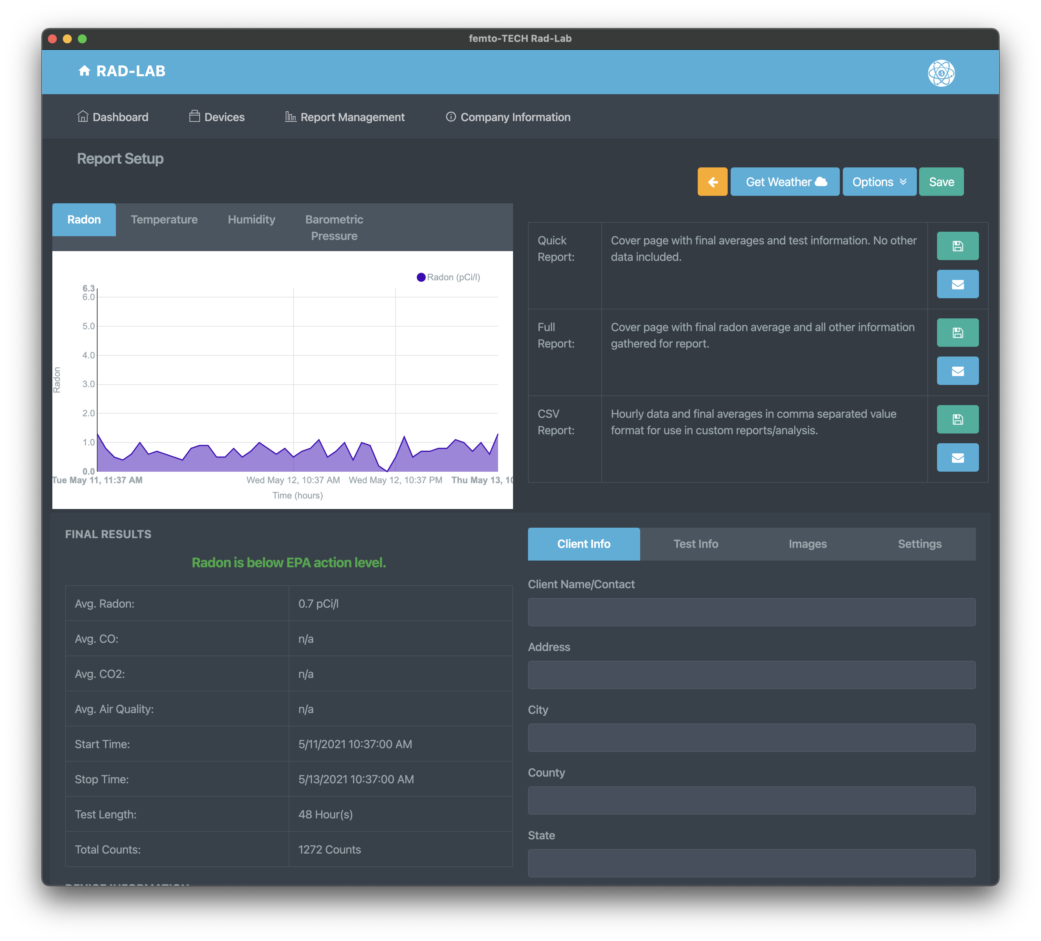



Report Management
Graphs plotted from the test data can be found in the top-left corner of the screen.
Results of the test can be found in the table on the bottom-left of the screen.
Hourly results can be read in table format via the button in the bottom-left corner below the ‘Final Results’ section.
The test-specific options menu can be found at the top-right of the screen. From here, you can change the units of each measurement as well as specify a span of time in which you would like to report on within the test.
The bottom-right section of the screen contains the report fields specific to the test being conducted. From here, you can add your customer’s information, test-specific information, images pertaining to the conducted test, and signatures.
Each section outlined on this slide will have a dedicated slide explaining its usage.

Slide 84
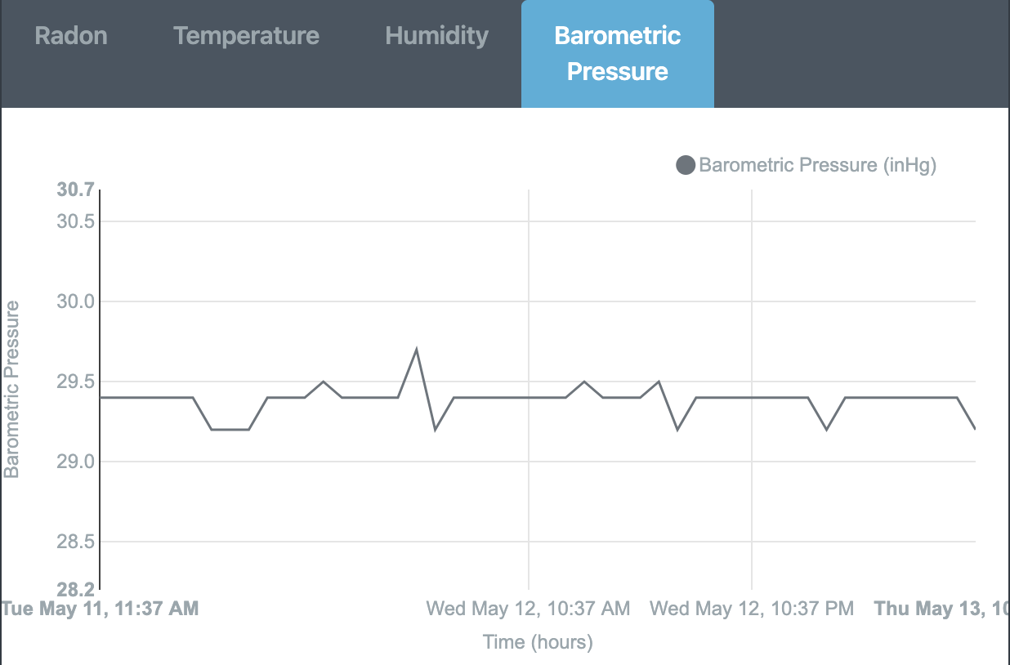
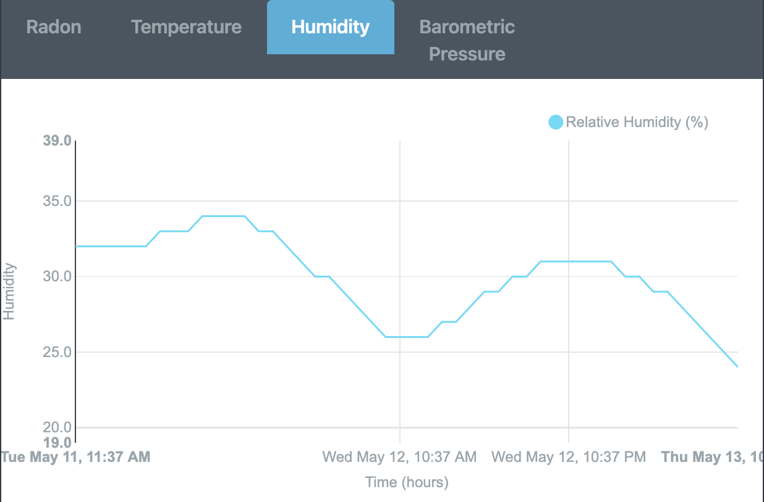
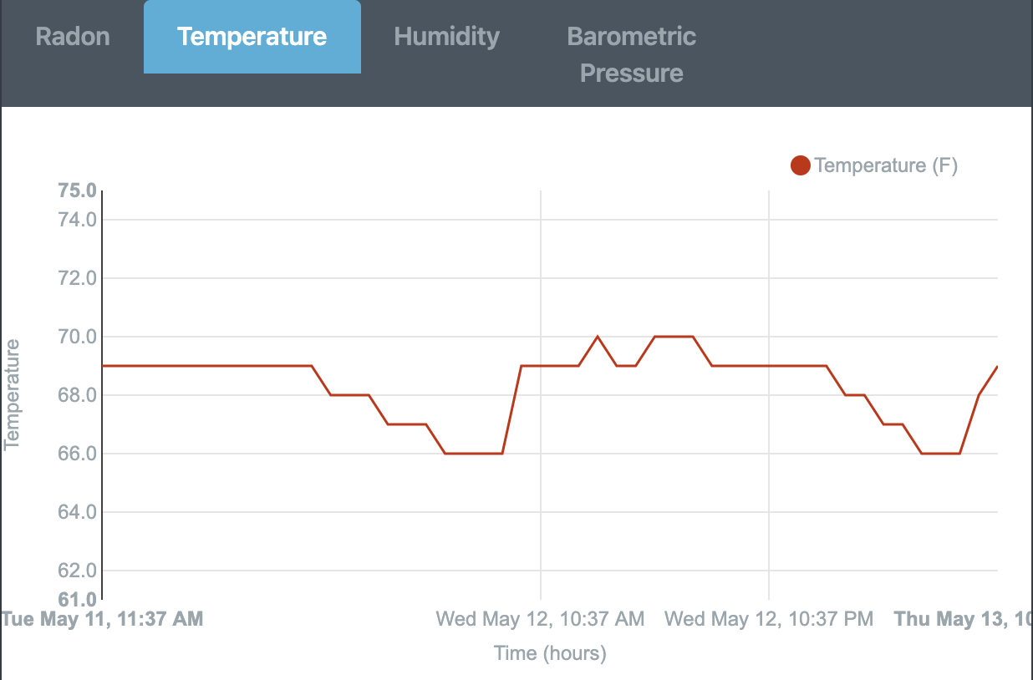
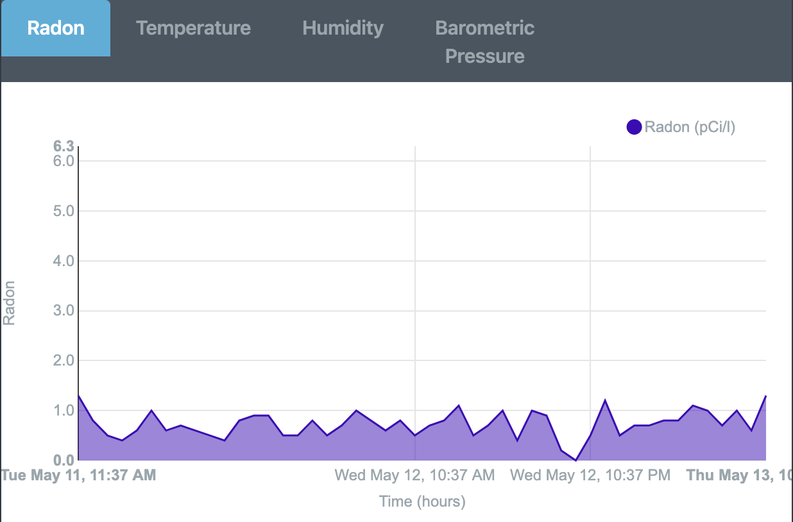
Report Setup (Graphing)
Each graph can be viewed by clicking its respective tab.
By hovering over the plots on each graph, you can view each hour’s value and exact time of recording.
Each graph is automatically adjusted/plotted whenever a specific range of hours is selected within the options menu (as seen on next slide).
The graphs can be enlarged by either maximizing your app window or turning your mobile device horizontally.

Slide 85
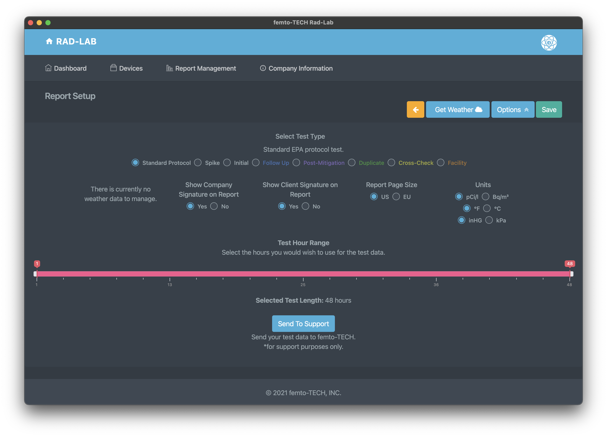


Report Setup (Options)
Click the ‘Options’ button to drop-down the options menu for the test.
From here, you can select the type of report you wish to generate. For most testing scenarios, the ‘Standard Protocol’ selection is adequate.
Below ‘Select Test Type’, you have the option to show weather data acquired for the test, as well as the company and client signatures. (All default to ‘Yes’ when applicable).
You can also change settings such as the report page size and the measurement units used for each field value and final average.
Select a test hour range to customize the hours that are being measured/reported. This feature can be used to accommodate a lack of closed-house conditions by running a longer test and manually selecting the span of hours. *Notice* a minimum of 44 contiguous hours are required per the EPA for protocol testing.
Click the ‘Options’ button again to hide the menu and simultaneously save your changes.

Slide 86
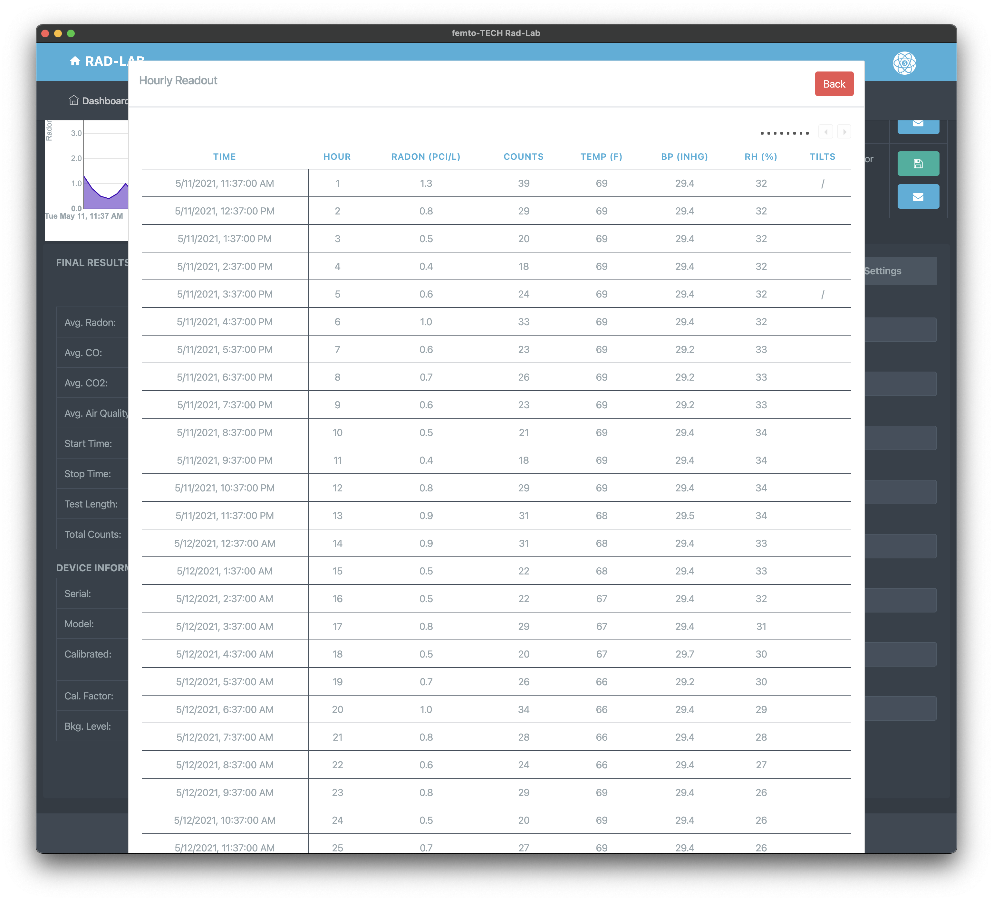

Report Setup (Hourly Readout)
Click the ‘View Readout’ button in the bottom-left side of the window to view the hourly table readout for each measured value.
If all columns are not showing on your screen, you can use the legend in the top-right of the table to navigate through the overflow columns.
Click the ‘Back’ button to close the hourly table readout and return to the previous screen.

Slide 87
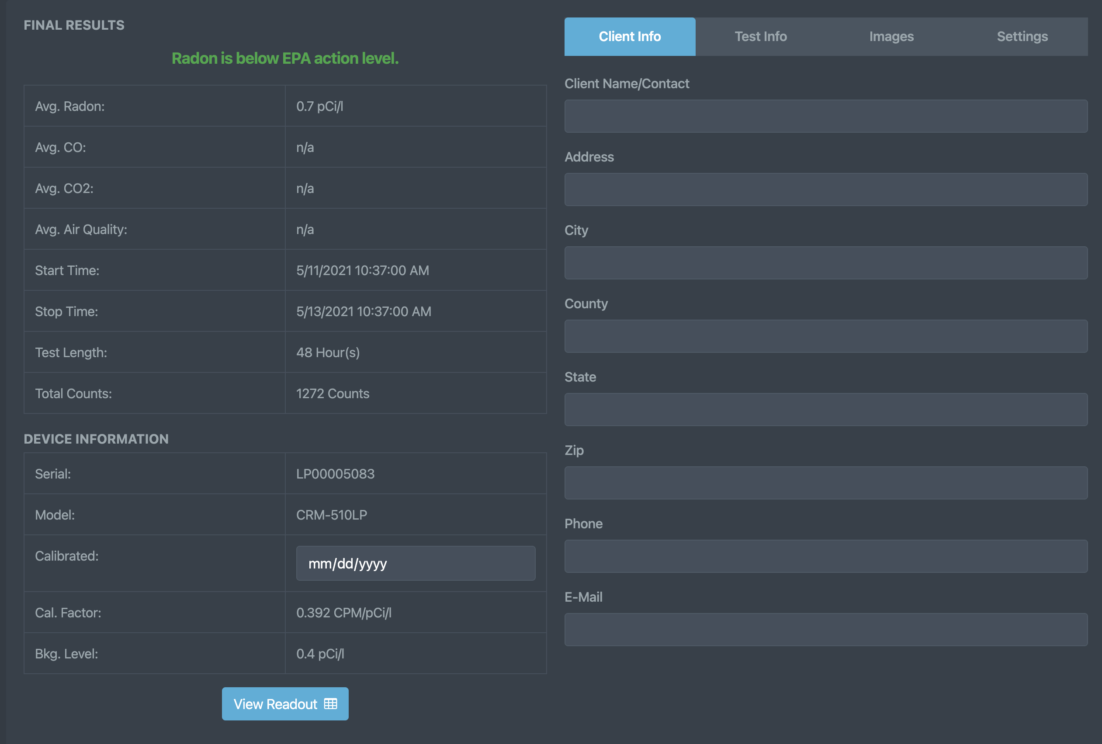

Report Setup (Client Information)
Click the ‘Client Information’ tab to enter/edit the information of the customer having the test completed.
These fields are used to populate the ‘Full Report’ as seen on the last slide of this show.
You can also add the calibration date of your CRM-510LP to the report. Once the date is selected, the software will remember that calibration date for that serial # until you change it again.

Slide 88
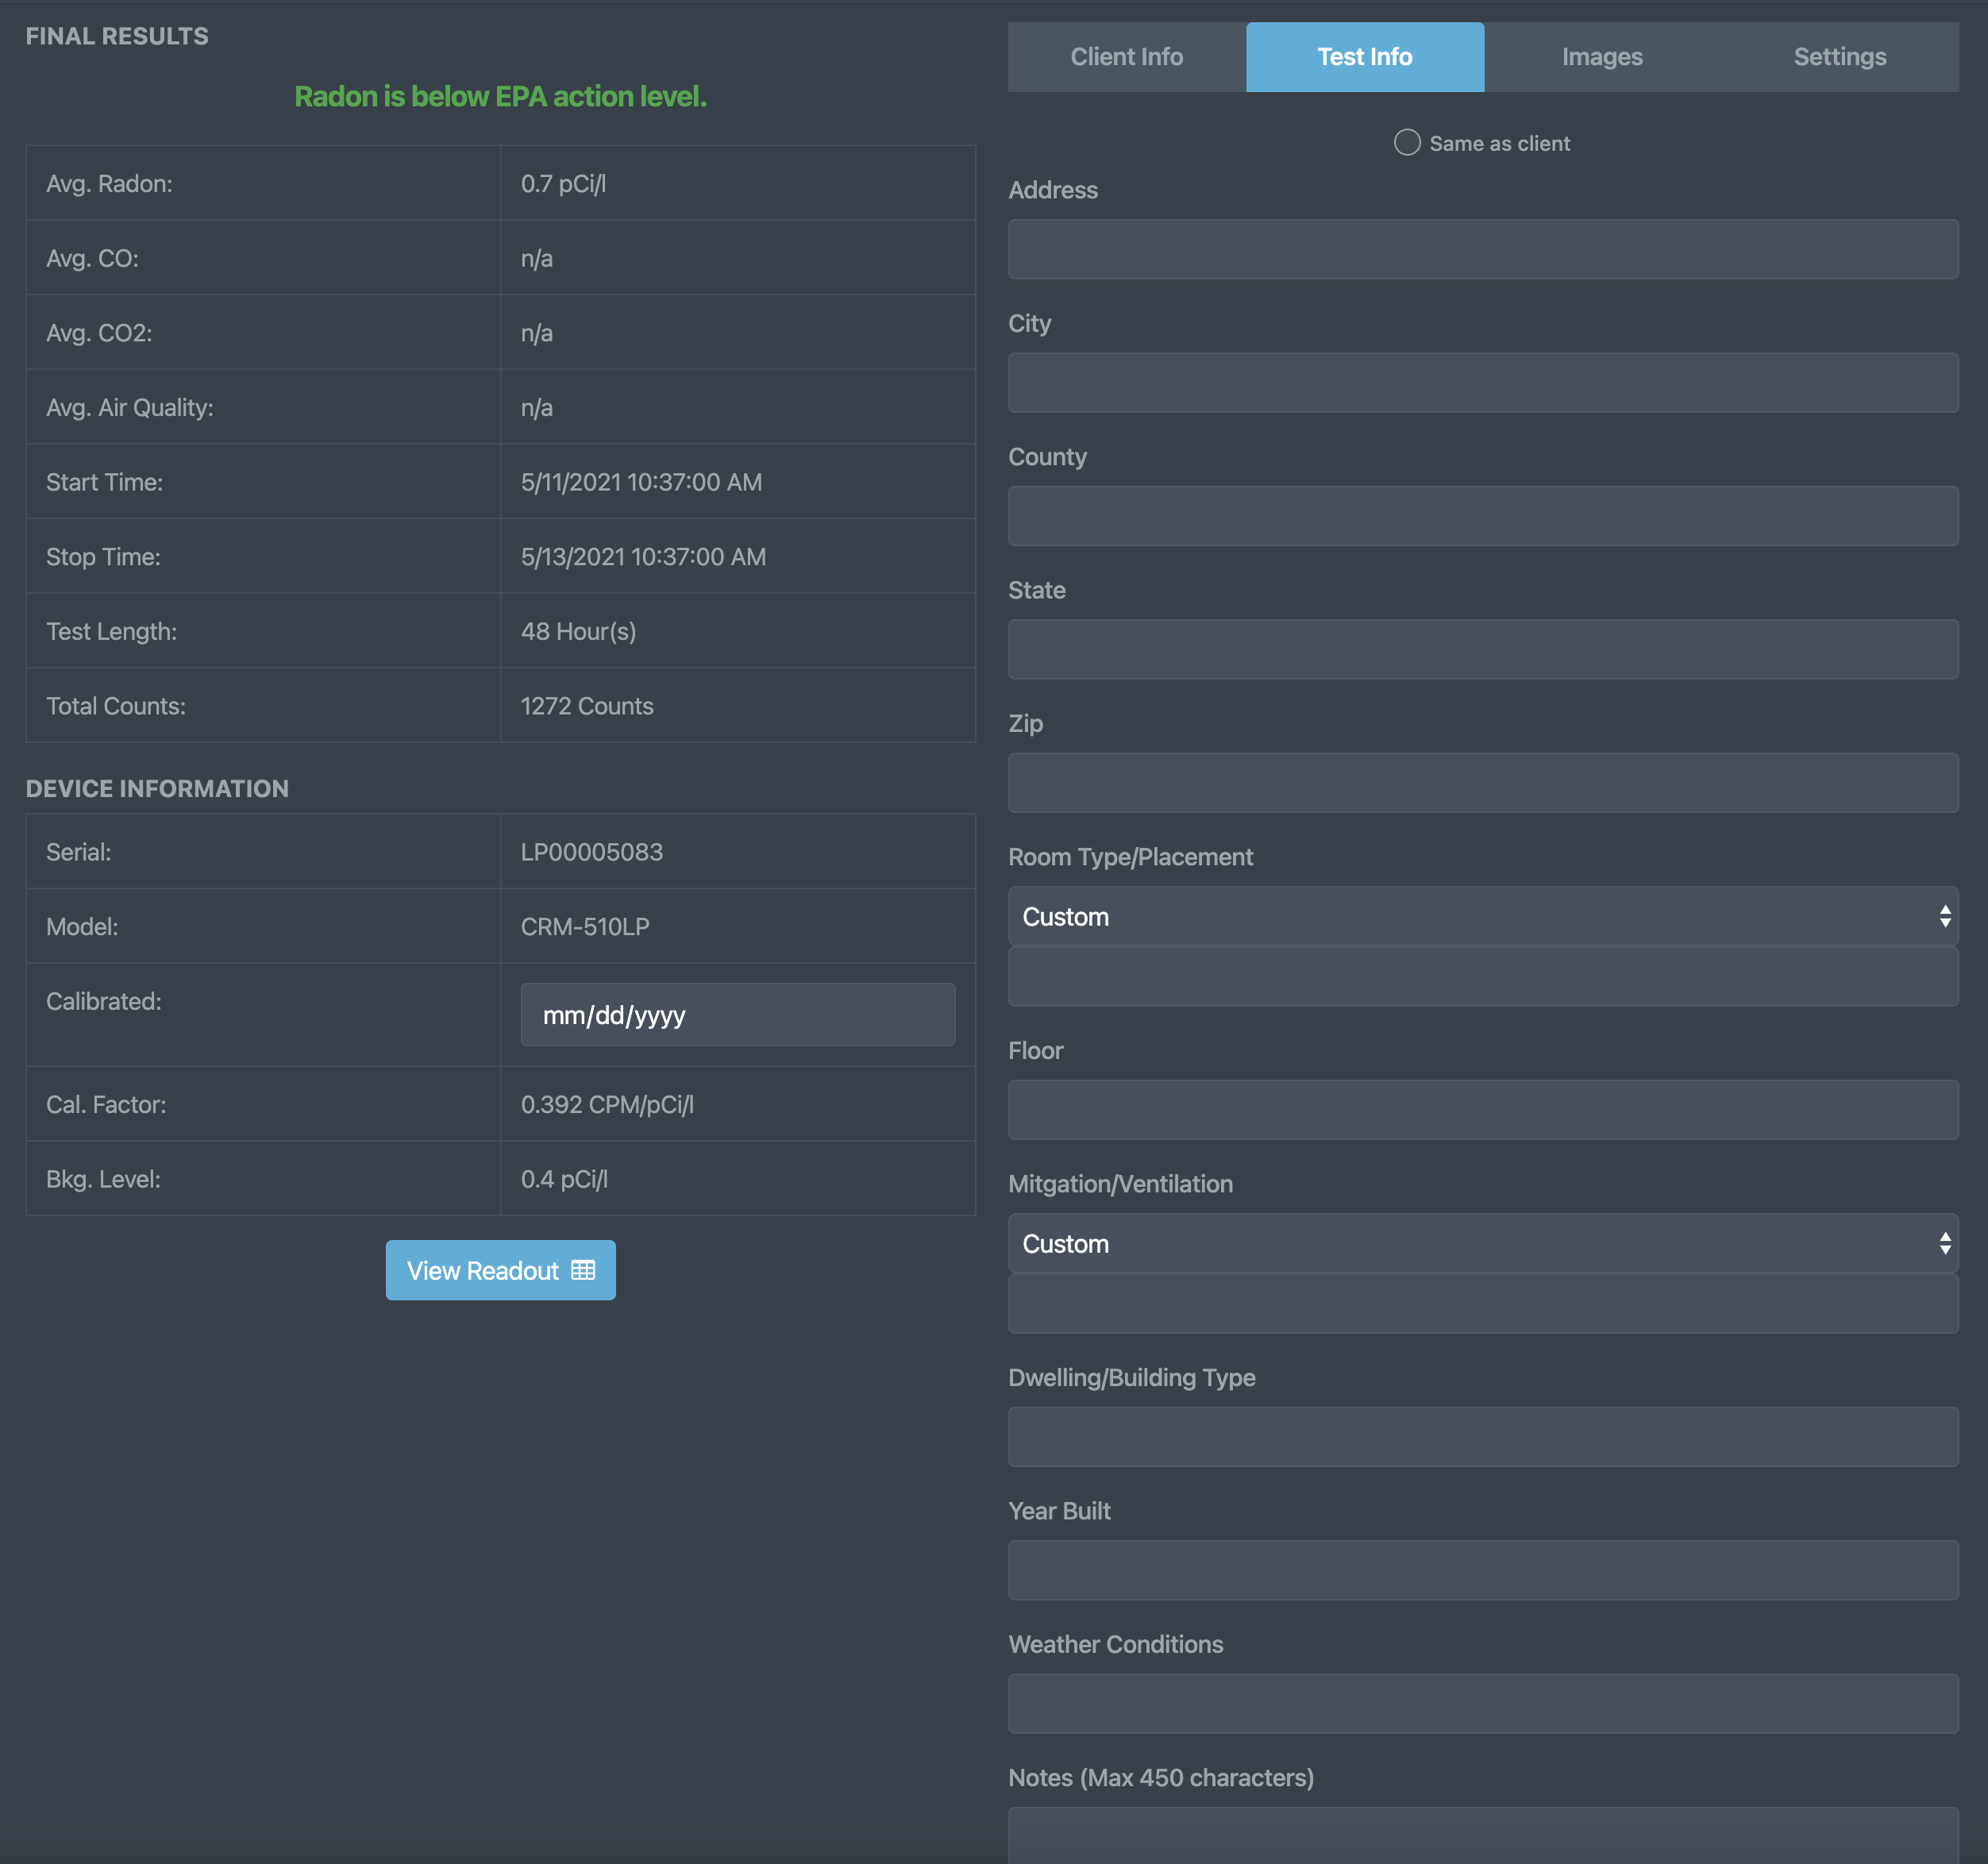
Report Setup
(Test Information)
Click the ‘Test Information’ tab to enter/edit any test-specific information.
These fields are also used to populate the ‘Full Report’ as seen on the last slide of this show.
Use the ‘Same as client’ button at the top to use the same address information as the client section.

Slide 89
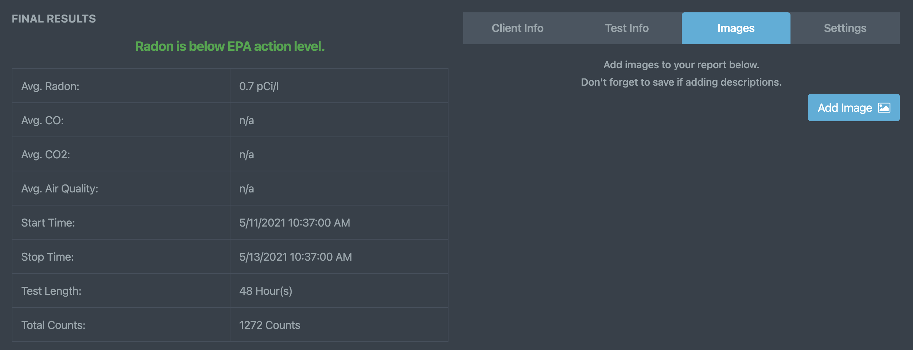
Report Setup
(Report Images & Attachments)
Click the ‘Report Images’ tab to add/take any images that are pertinent to the test being conducted.
Once an image is added, you will have the option to add an image description.
Each image and its accompanying description will automatically be added to your report once saved.
Click Add Report Page to add a PDF or other report material to the Radon Report within its own dedicated page.

Slide 90
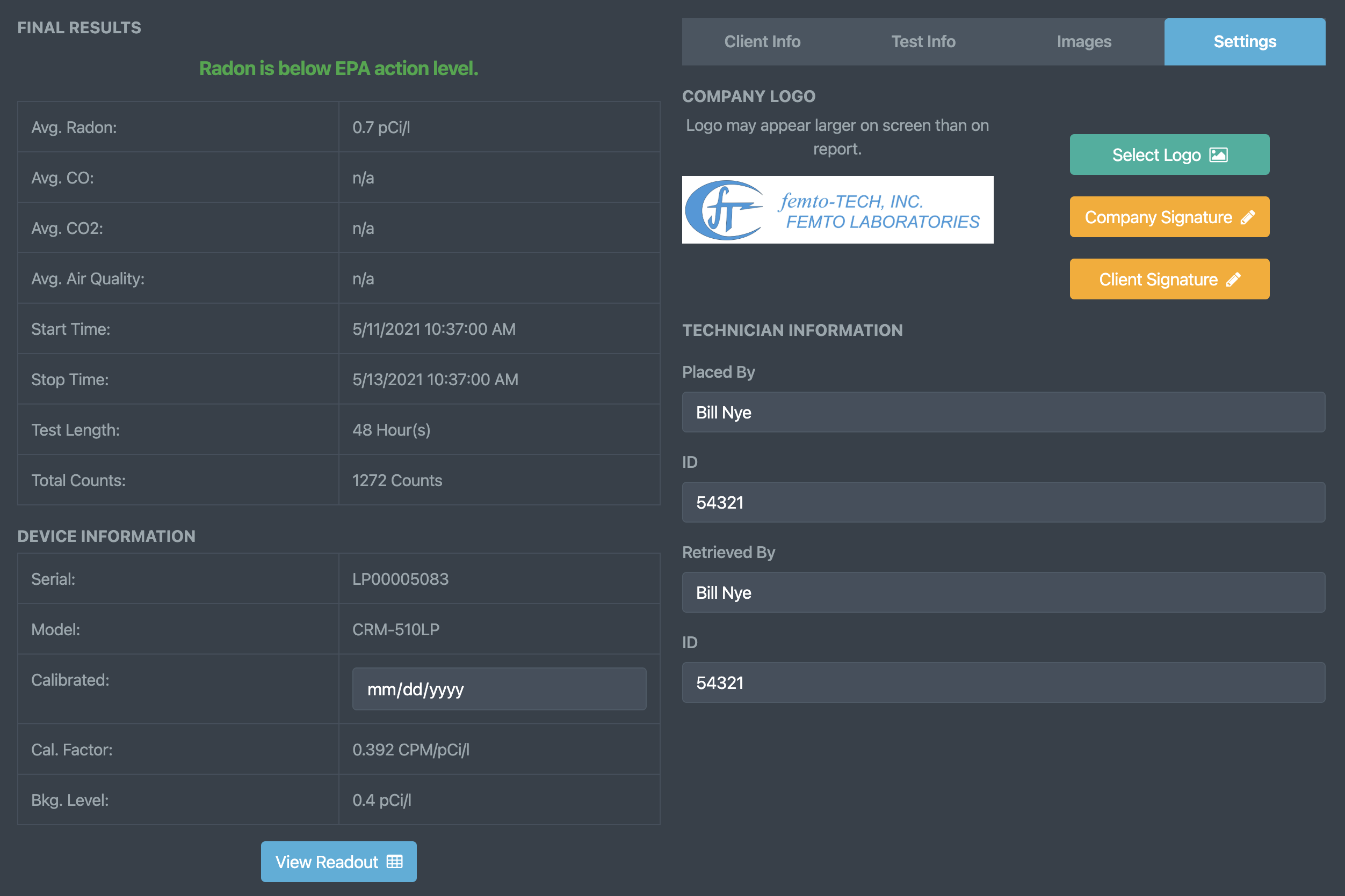
Report Setup
(Report Settings)
Click the ‘Report Settings’ tab to put the final touches on your generated report.
Click the ‘Select Logo’ button to change the logo you would like to be added to the top of the report.
Click ‘Company Signature’ to add/remove a signature for the person representing your company.
Click ‘Client Signature’ to add/remove a signature for the customer acknowledging the completion of the test.
The Technician Information can also be added/edited here in case that person were to change test-to-test.

Slide 91
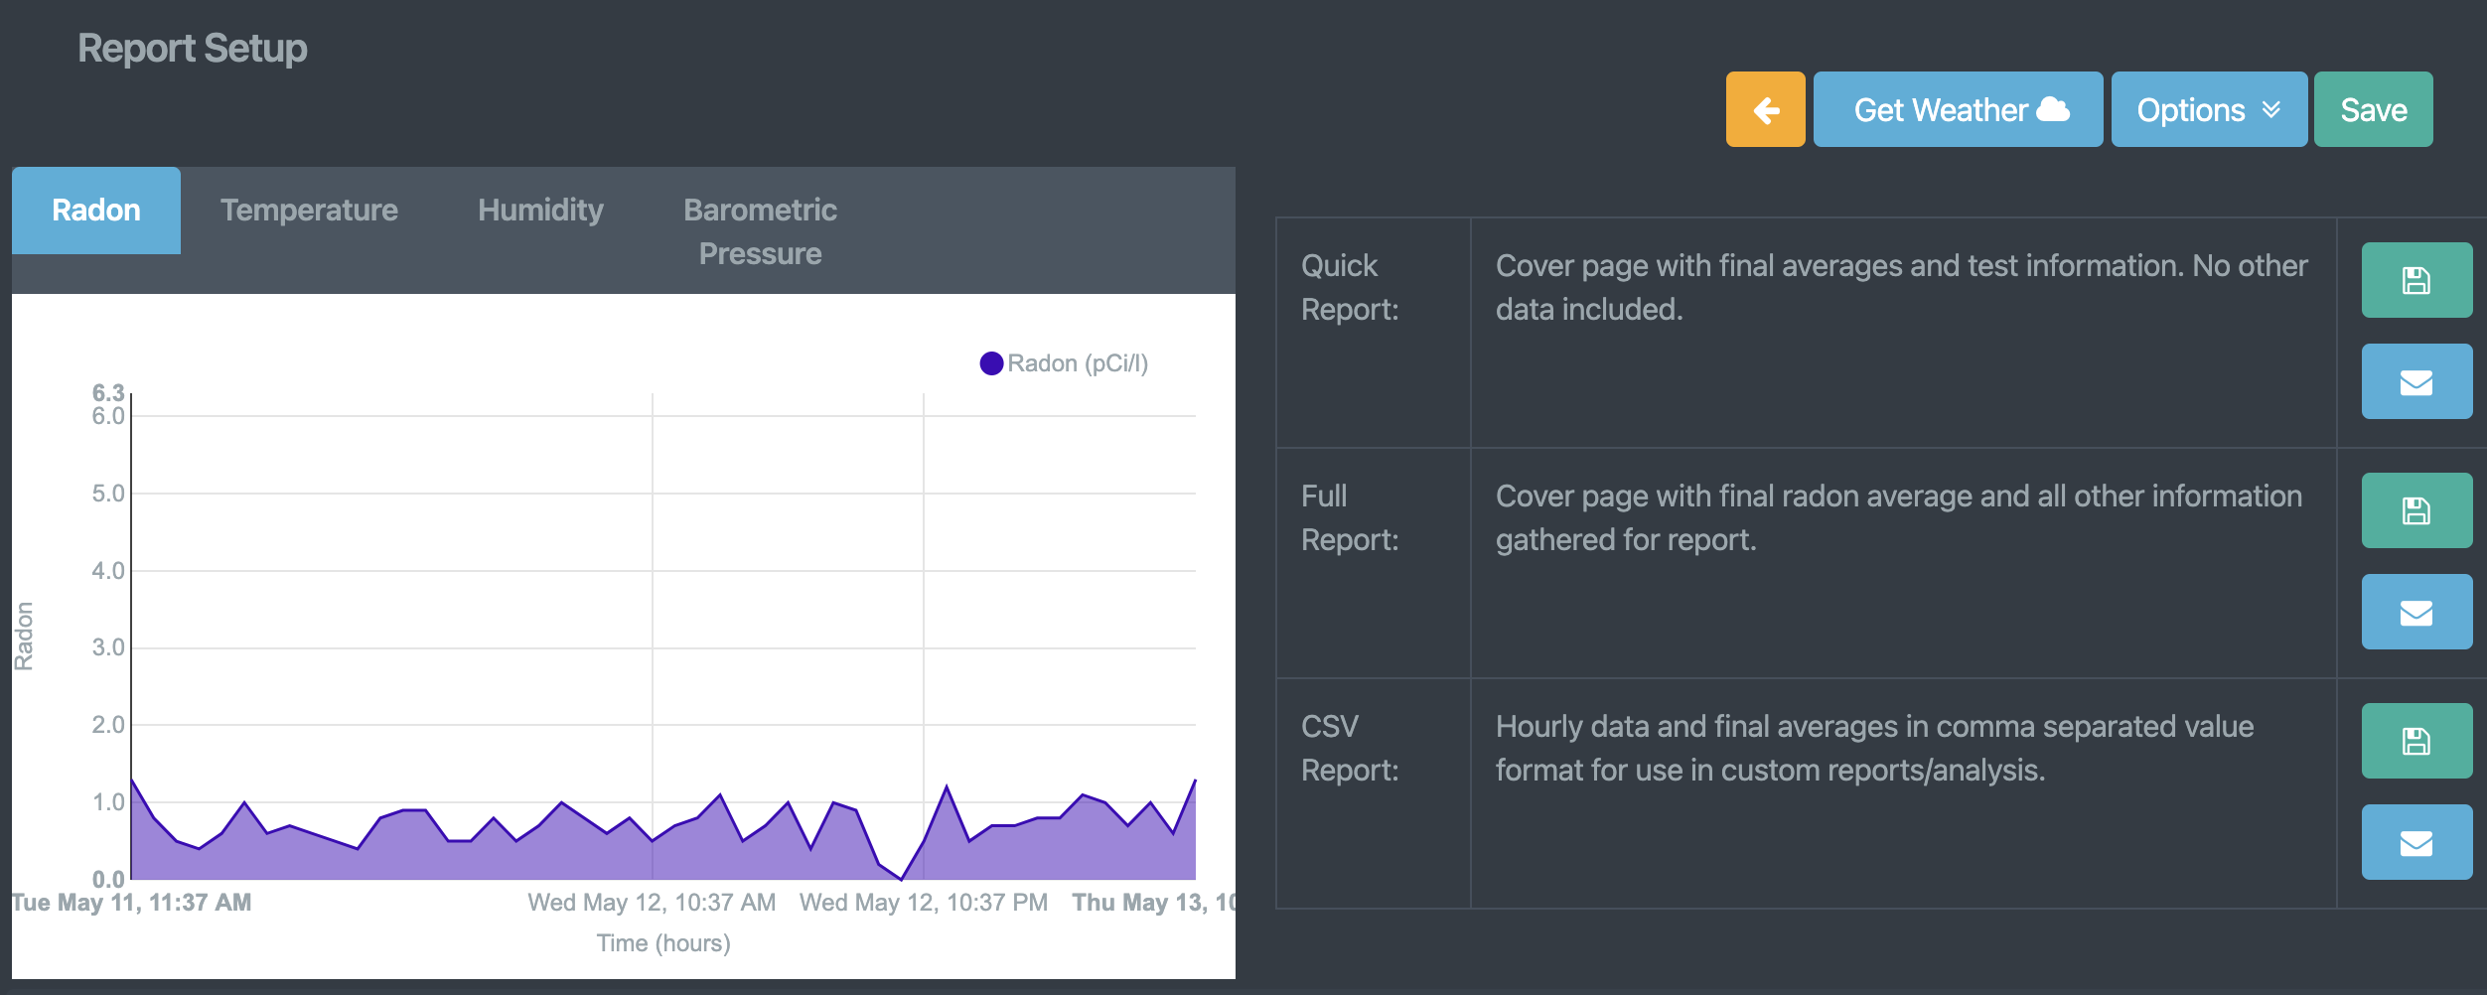
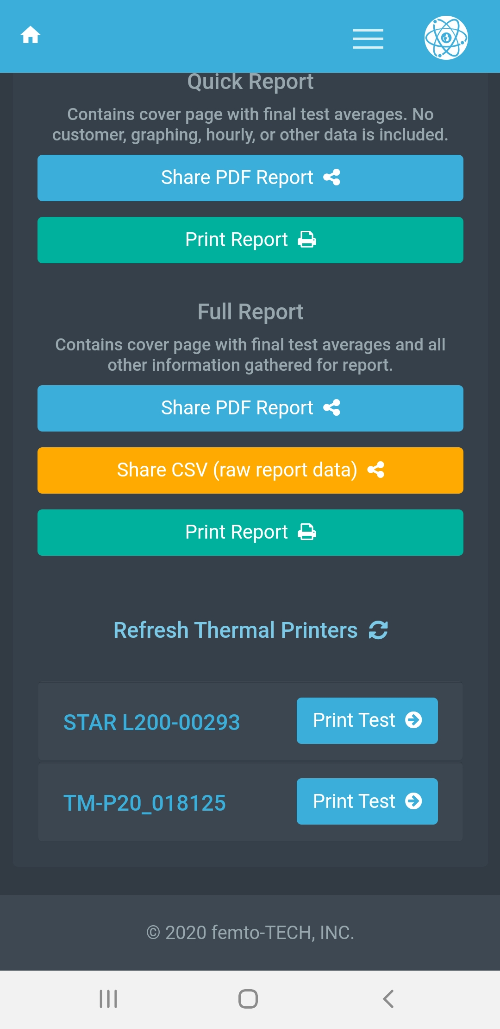



Report Setup
(Generating Report)
There are 3 types of reports that can be generated from your test data. (Quick, Full, & CSV Reports)
Quick - Cover page with final averages only. No other data included.
Full - Cover page with final test averages and all other information gathered for report.
CSV - Hourly data and final averages in comma separated value format for use in custom reports/analysis.
Mobile Only - Report can be shared/sent via your preferred method (email, message, other 3rd party apps) by clicking their respective ‘Share’ buttons.
Mobile Only - Report can be printed directly to a networked printer if the printer has already been installed for use on your phone and you are connected to the same network.
Mobile Only - Report can be printed directly to a supported BLE thermal printer from within the ‘Settings tab’ on your mobile device.
Print via Bluetooth Thermal Printer - First, make sure the thermal printer is turned on and already paired to your device. Once that step is complete, click ‘Refresh Thermal Printers’ to populate the list with connected printers. Once on the list, click ‘Print Test’ to send the test data to the printer.

Slide 92



Report Setup
(Sharing via E-mail)
Click the button containing the mail icon for either of the 3 reports to generate and immediately share via e-mail. You can customize the e-mail that is sent and then save it as a template to be used for future e-mails. *Notice* - a valid e-mail account must be used for this feature to work properly. If you lack a valid e-mail or cannot get yours to work, femto-TECH provides a free option that can be found in the global settings menu. Select ‘femto-TECH’ as the email provider and be sure you have an e-mail configured in your company information for it to work properly.

Slide 93








Tamper Detection
Each CRM-510LP is equipped with a tilt sensor that logs movement within the hour of detection (logs to graph and hourly readout).
Along with the tilt sensor, the 510LP also measures temperature, humidity, and barometric pressure – all of which can be used for tamper detection.
As you can see on the graphs to the right, there is clear indication of tampering occurring in this test due to the tilt indicators and sudden changes seen within those hours. Based on these indicators, it is also evident that this tampering has had a direct effect on the measured radon.

Slide 94

Influence of Environmental Factors
The CRM-510LP by design is resilient to most environmental influences that might influence the measurement of radon.
The most concerning environmental influencer is condensing humidity. Condensing humidity is when water collects on the surfaces of anything that has a certain temperature relative to the surrounding area temperature in a high humidity environment.
This can occur in basements with temperatures lower and humidity higher than normal livable conditions, or if the CRM was brought into a high humidity/low temperature environment after directly being outside in the dry/hot weather.
If water is to condense on the internal circuitry of the CRM, there is a chance that the electronics will be compromised, and the radon readings could suddenly show as 0.0 or spike to above-average levels.
Avoid starting a test in a cold and wet basement directly after taking the CRM out of your hot vehicle.

Slide 95






Data Interference
Condensing Humidity
EMF
Notice the sudden drop in temperature and rise in humidity at the start of the test. The average temperature and humidity are conducive to an environment in which condensing humidity can occur. With these conditions it is possible for the electrometer to ‘run away’.
It is possible to overwhelm the electrometer on the CRM-510LP if it is placed near high-powered radio equipment such as modems/routers/cellular devices. Make sure to place your CRM at least 10 feet away from any wireless transmitting devices.

Slide 96
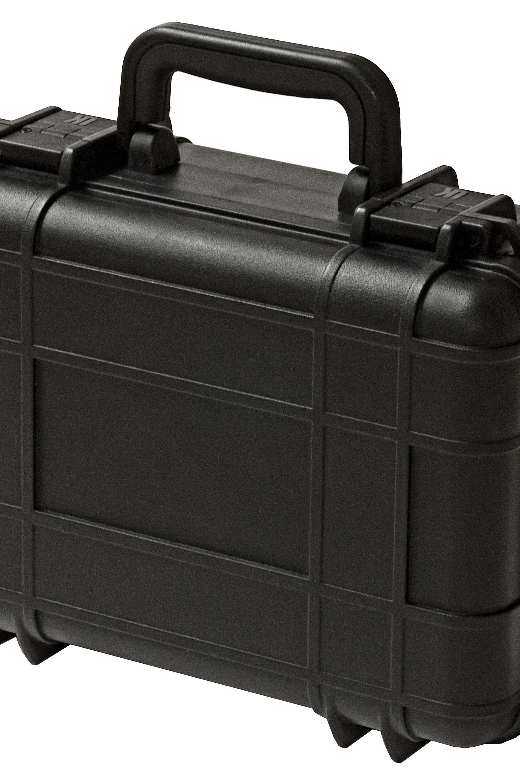
Device Handling & Storage
Femto-TECH devices are commonly known as industry “work horses”. They are designed to be rugged and hold up to the rigors of day-to-day inspections.
It is recommended to store your CRM-510LP in a drop and weather resistant case to prolong its lifespan and keep it safe while moving from location to location. To prevent theft, it is not recommended to leave your devices unattended in any vehicles.
Our devices are known to last for decades due to the quality of materials used and the limited-lifetime warranty we apply to their electronics.

Slide 97

Congratulations on the purchase/rental of your femto-TECH CRM!

